Slide 1
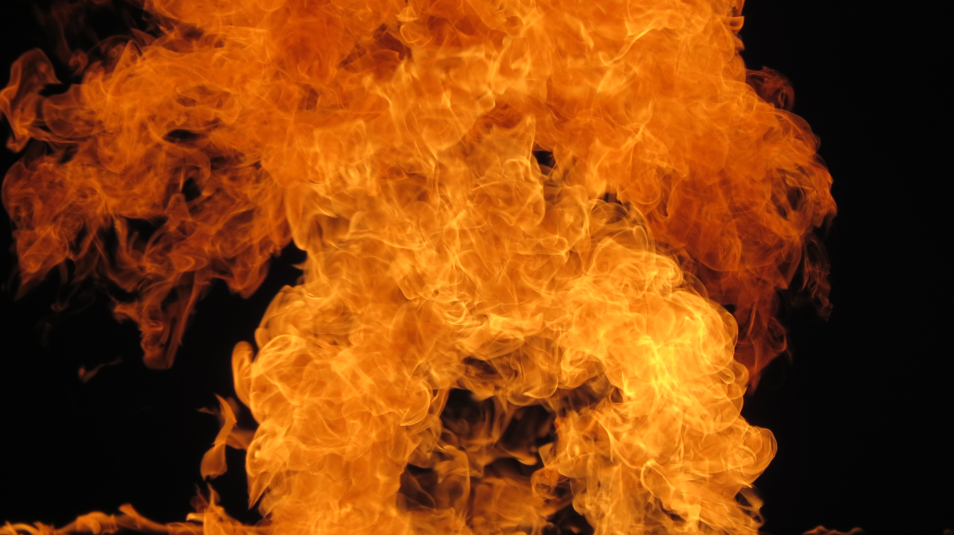
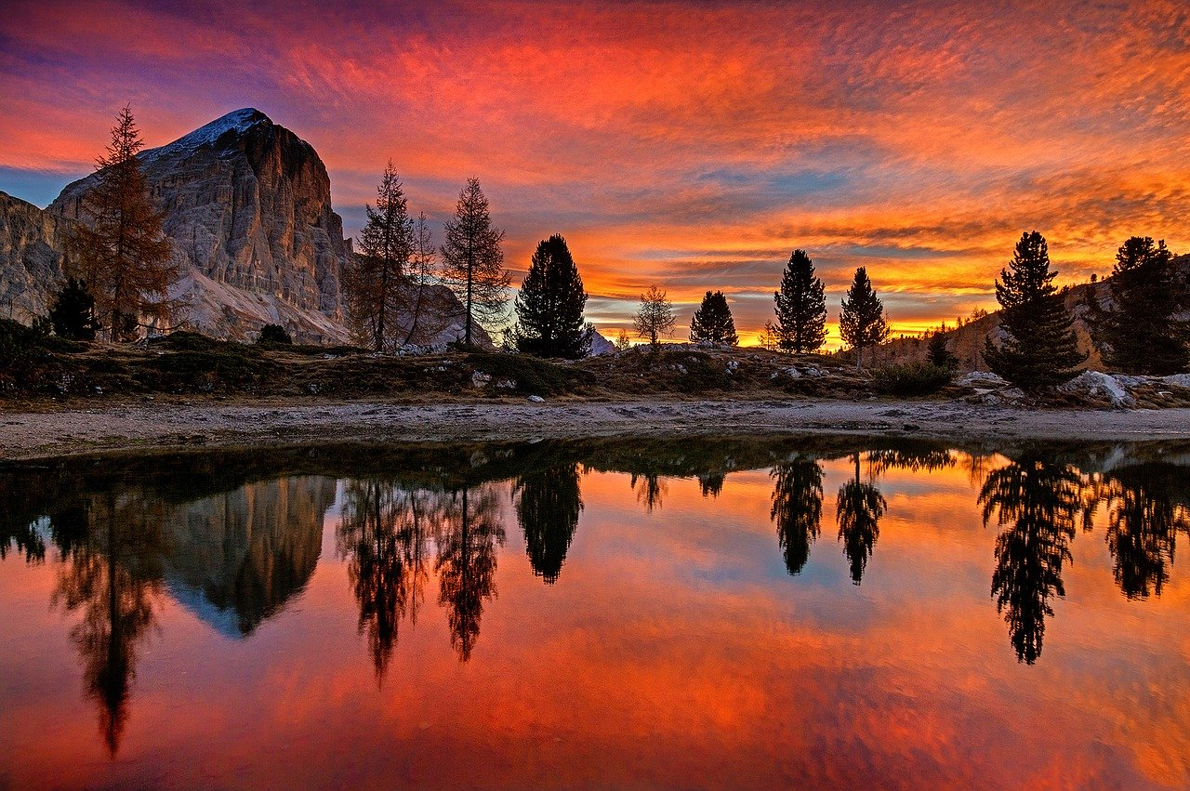
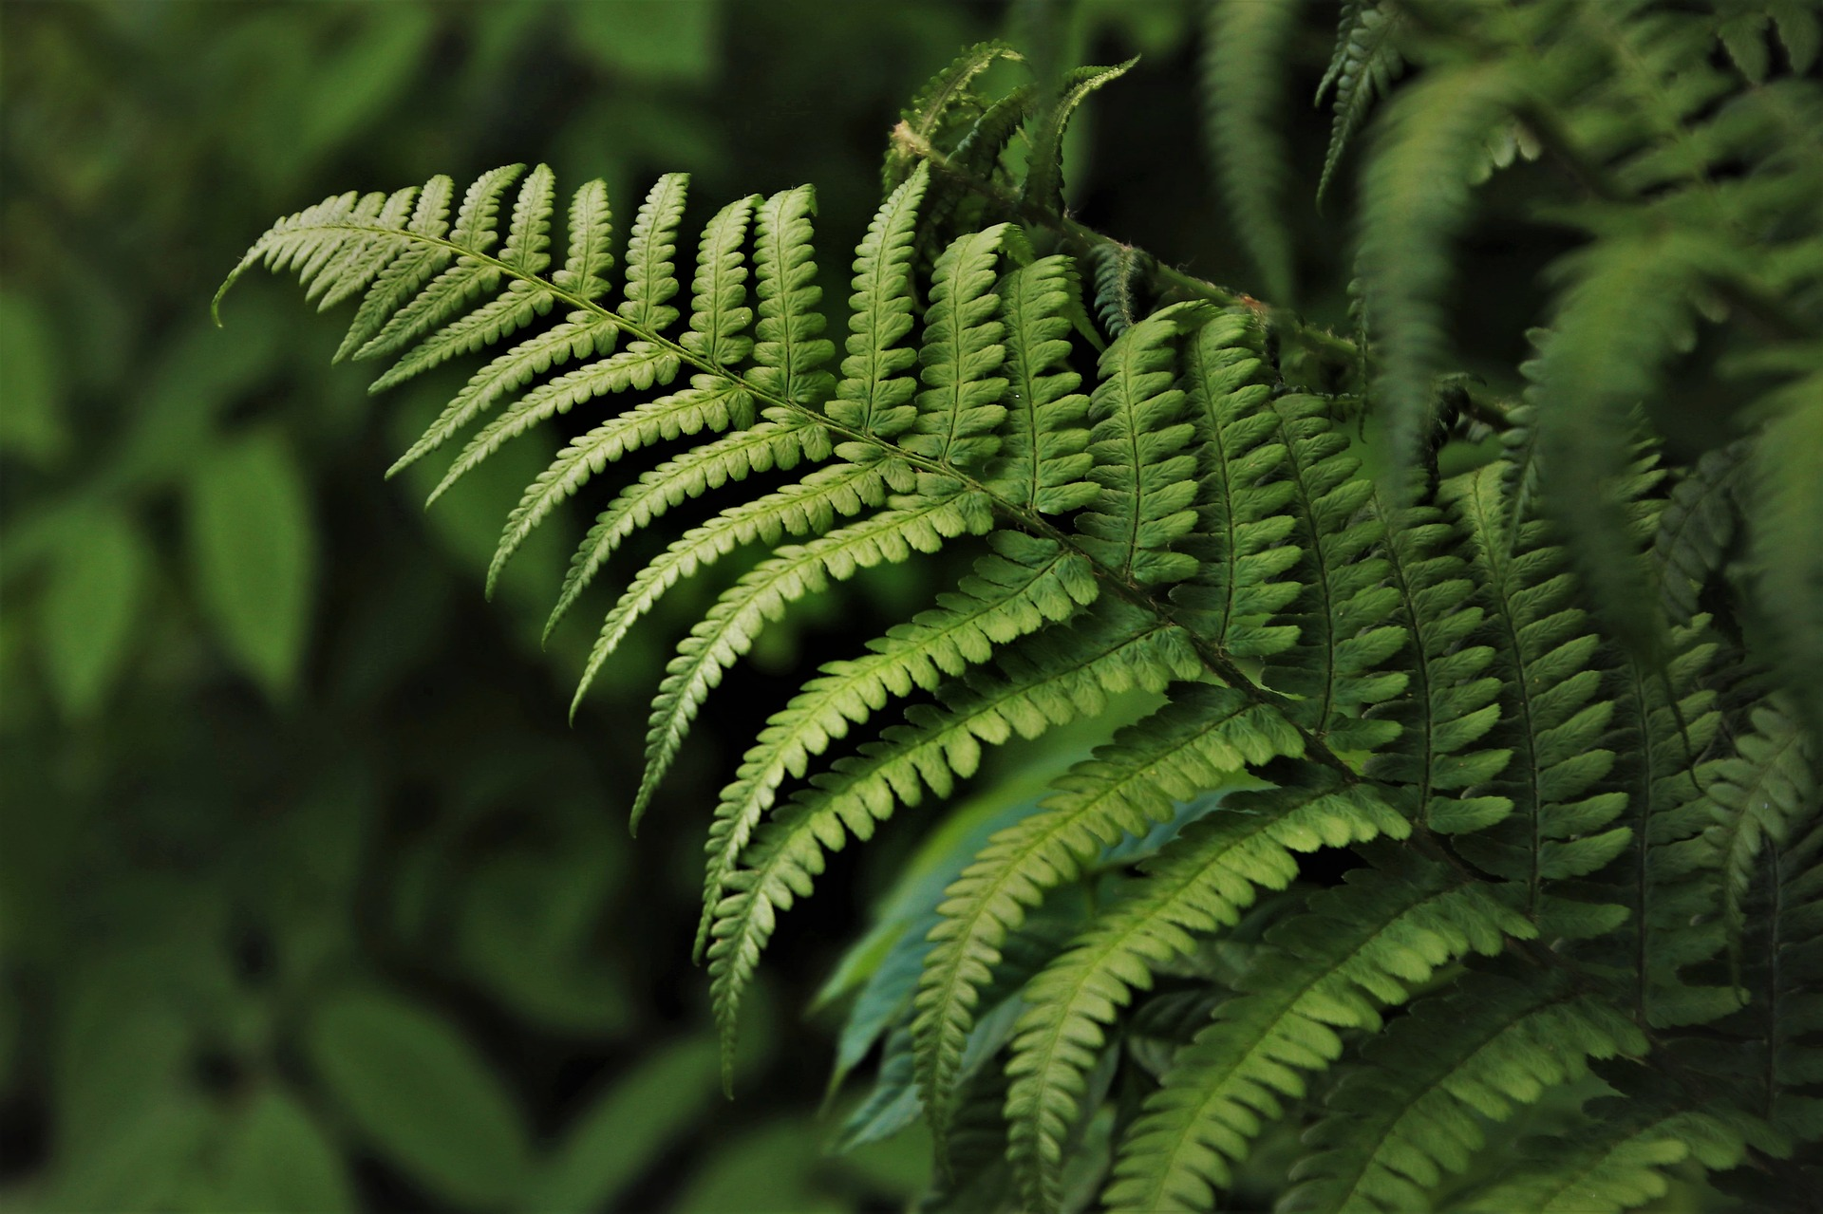
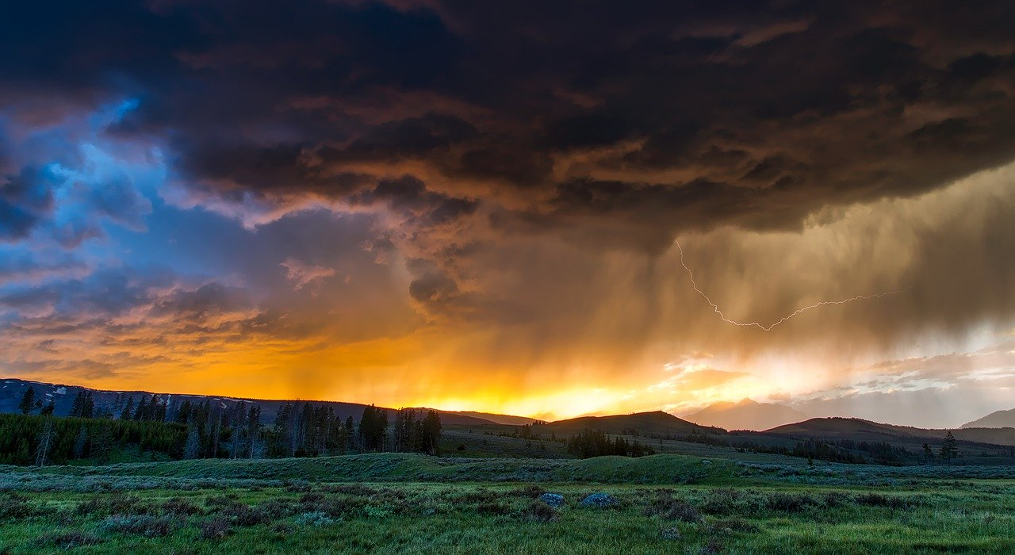

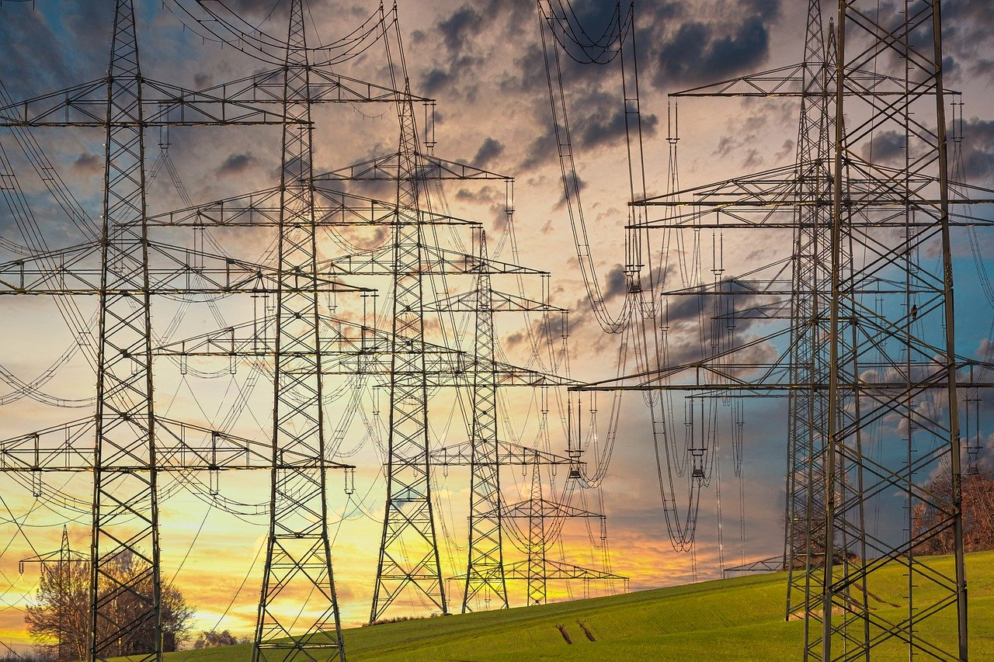

Data-Driven Wildfire Risk Prediction with augmented spatial accuracy
Team 4
Megha Rajam Rao
Venkata Anil Kumar Thota Qiao Liu
Nandini Puppala
Prathusha Koouri
Guide:
Dr. Jerry Gao
Advisor:
Dr. Lee Chang

Slide 2
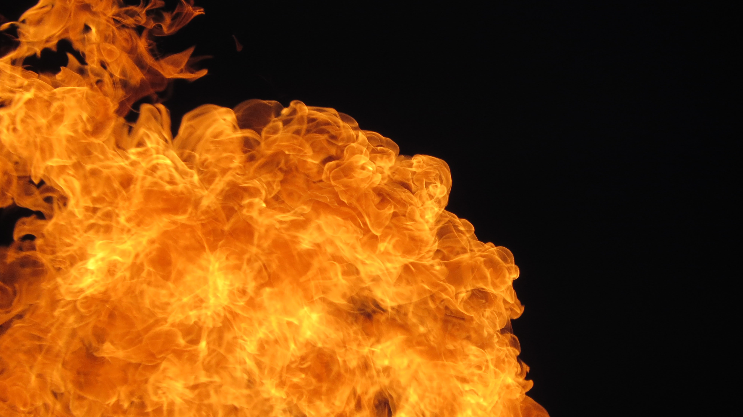
Outline
Fire Statistics
Project Overview
Comparison of different systems
Study Area
Data-related Statistics
Weather Data
Powerline Data
Terrain Data
Fire History Data
Vegetation Data
Proposed Solutions
Model experiments
Model Architecture
Threshold Tuning
Evaluation Metrics
Conclusion
Lessons Learned
Recommendations
Demo

Slide 3
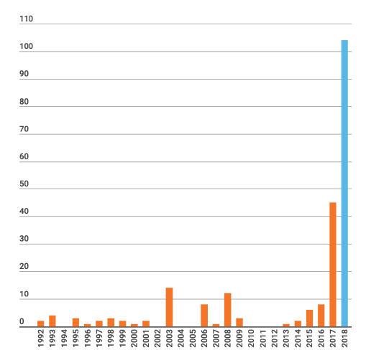
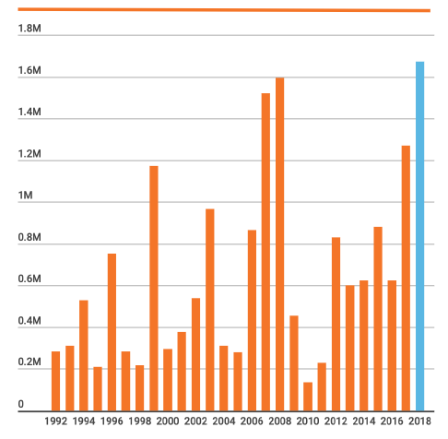
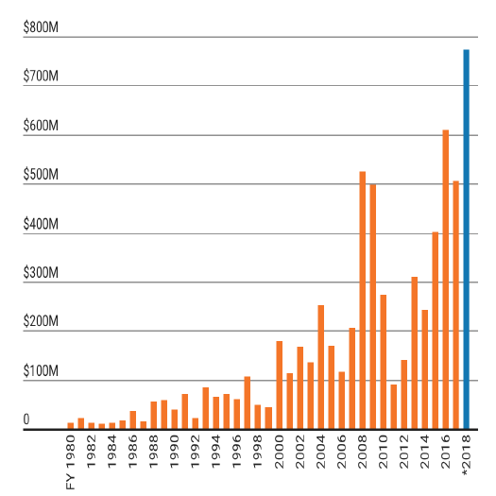
Fire statistics show the rapid increase of wildfire damage in California. Blue bar shows the largest numbers. The year 2018, deemed one of the worst years in California history, witnessed 7571 fires that burned across 1.6 million acres of land and claimed more than 100 lives.
Fire Statistics
Cost of Wildfires from the year 1980 to 2018
Yearly death toll in California
Yearly Estimation of acreage burned in California

Slide 4
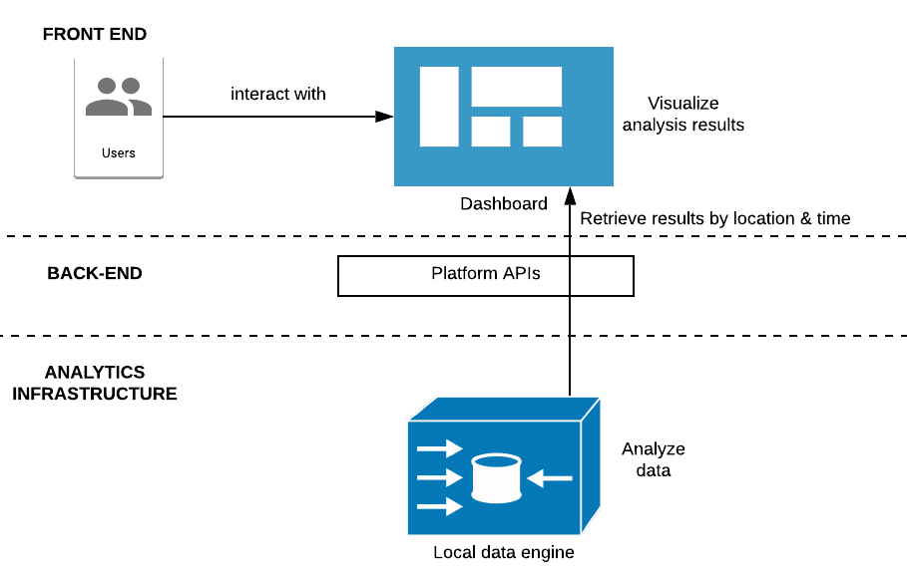

Project Overview
Objective: Build a model that improves accuracy for predicting wildfire risk in Northern California.
Purpose: Create a wildfire risk prediction system that would help concerned agencies such as Cal Fire.
Outcome: A ML model with augmented sensitivity that can predict local wildfire probability to a 92% accuracy, along with an interactive user Interface.

Slide 5
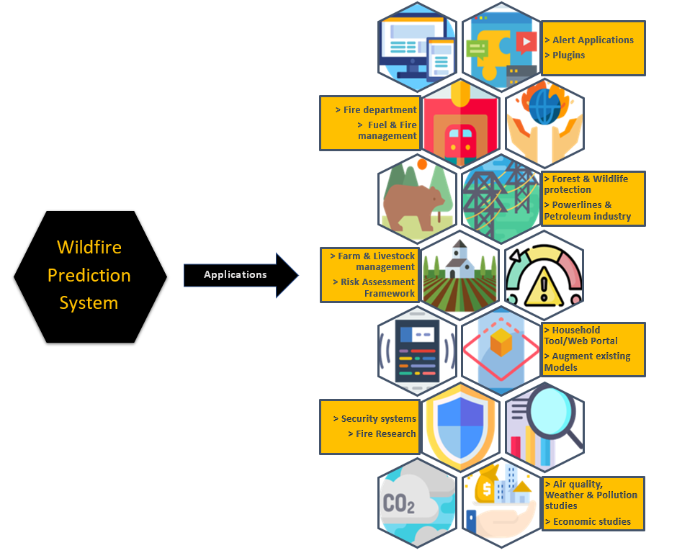
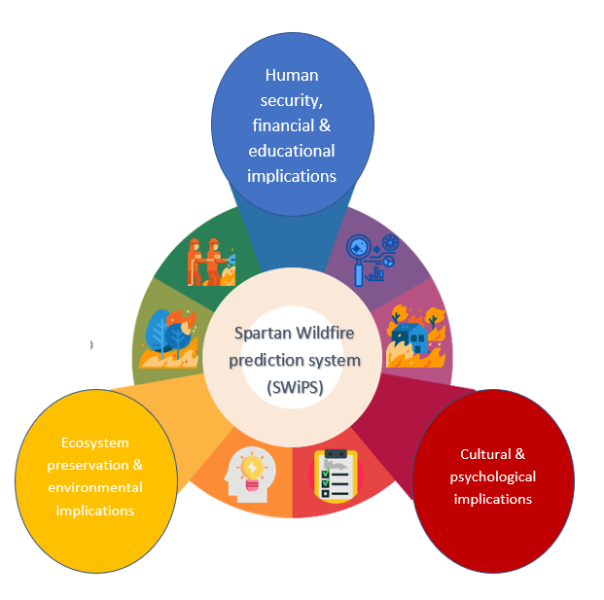
Need for this project
Applications
Implications

Slide 6
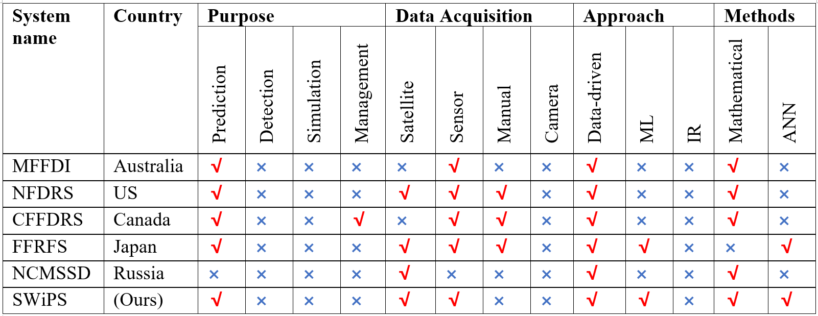
Comparison of different systems

Slide 7
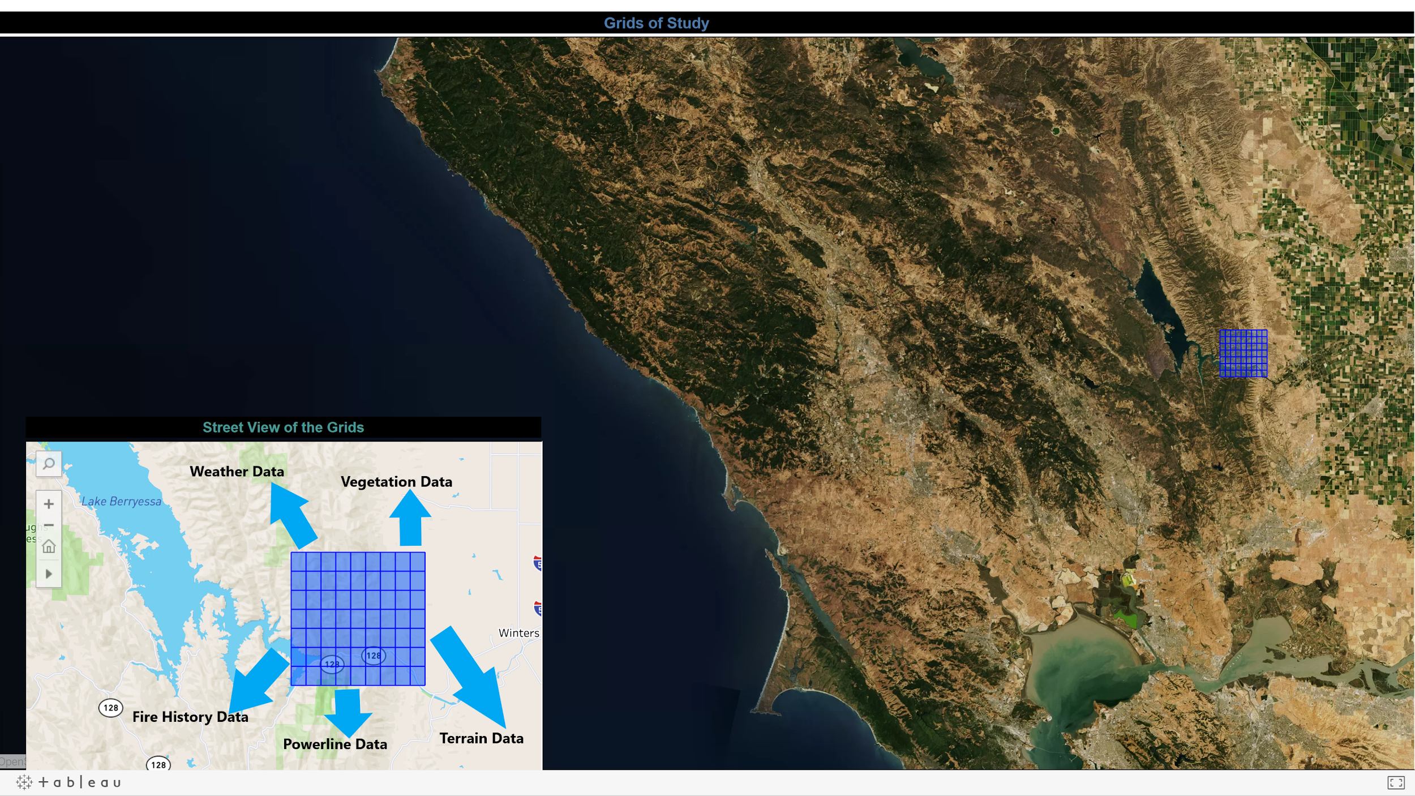
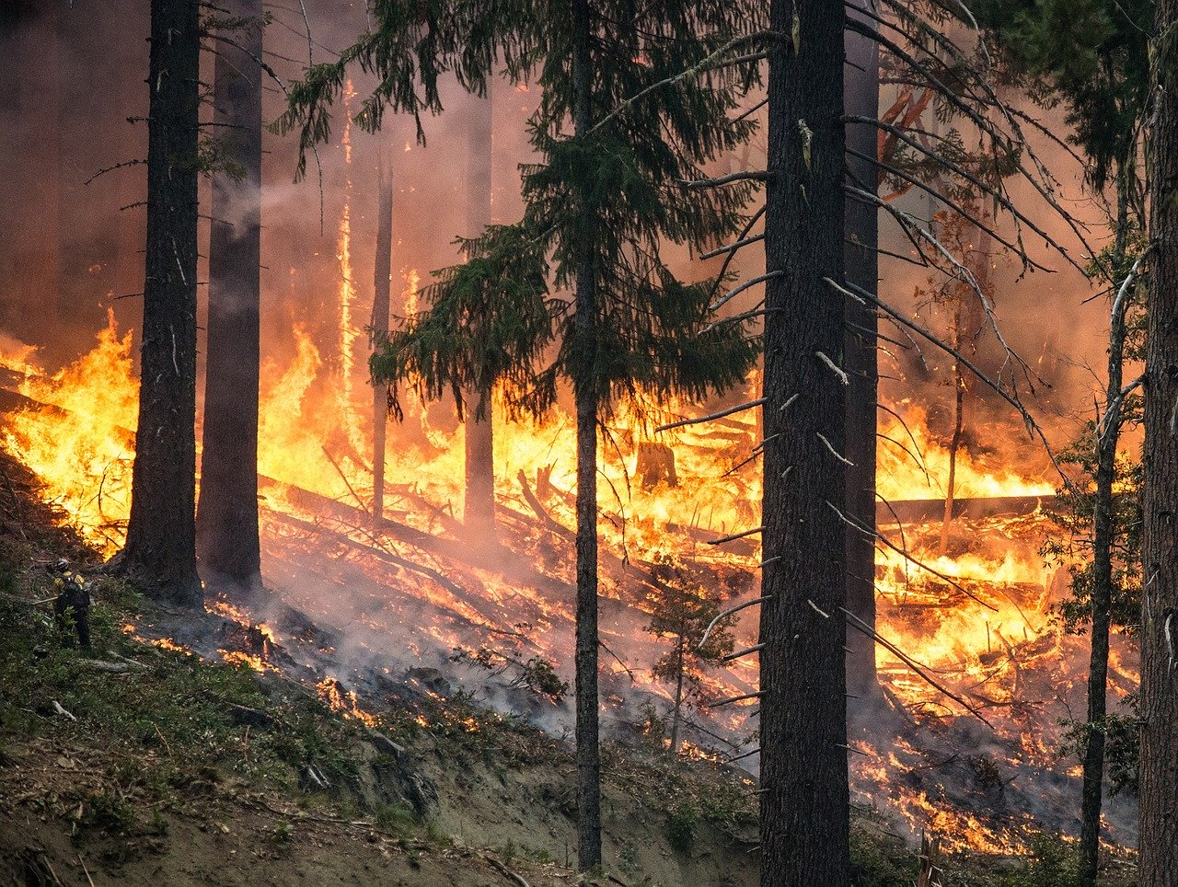
Study Area
Fire-prone Area divided to 63 grids.
Dimension: 7 rows and 9 columns.
Size: 1km*1km
Area: 3969 km ^2

Slide 8
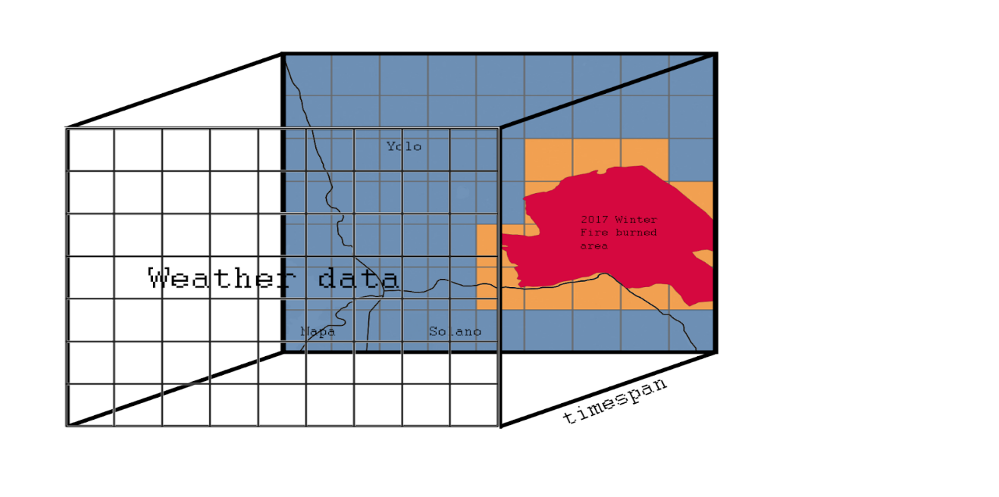
Weather Data
Fields | Description | Range | Unit
WBAN | WBAN is a five-digit number used for digital data storage and weather station identification. | (117, 94299) | NA
Latitude | Latitude of the weather station | (32.81667, 41.78139) | Degree
Longitude | Longitude of the weather station | (-115.57861, -124.23667) | Degree
Elevation | Elevation of the weather station | (-17.7, 2172.6) | Meter
Date | Time at which different weather parameters are captured. | (01/01/2016, 12/31/2018) | NA
Hourly DryBulb Temperature | Dry Bulb Temperature of air at the weather station. | (-22.0, 115.0) | Fahrenheit
Hourly Relative Humidity | Relative humidity at the weather station. | (1.0, 100.0) | Percentage
Hourly WindSpeed | Wind speed at the station. | (0.0, 57.0) | Miles per Hour (mph)
Hourly Precipitation | Precipitation at the station. | (0.0, 10.31) | Inches to Hundredths
Weather data from Local Climatology Data (LCD) is maintained by National Centers for Environmental Information (NCEI) which provides atmospheric and geospatial data across the United States.
Format – csv file
Date range - 01/01/2015 to 12/31/2019.
Frequency - Hourly
Source - https://www.ncdc.noaa.gov/cdo-web/datatools/lcd.
Size – 168 MB

Slide 9
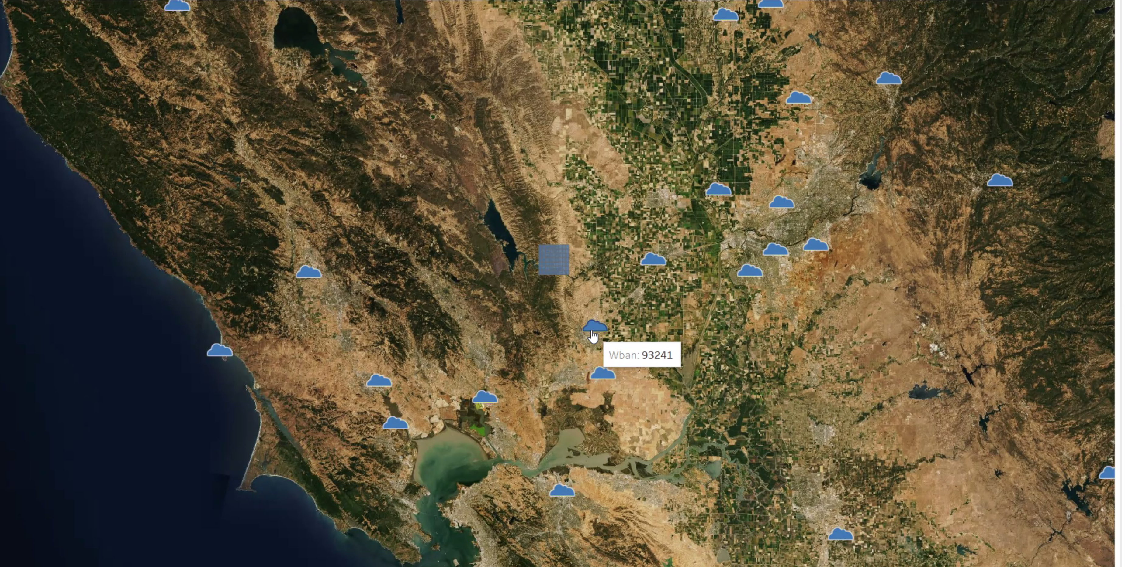
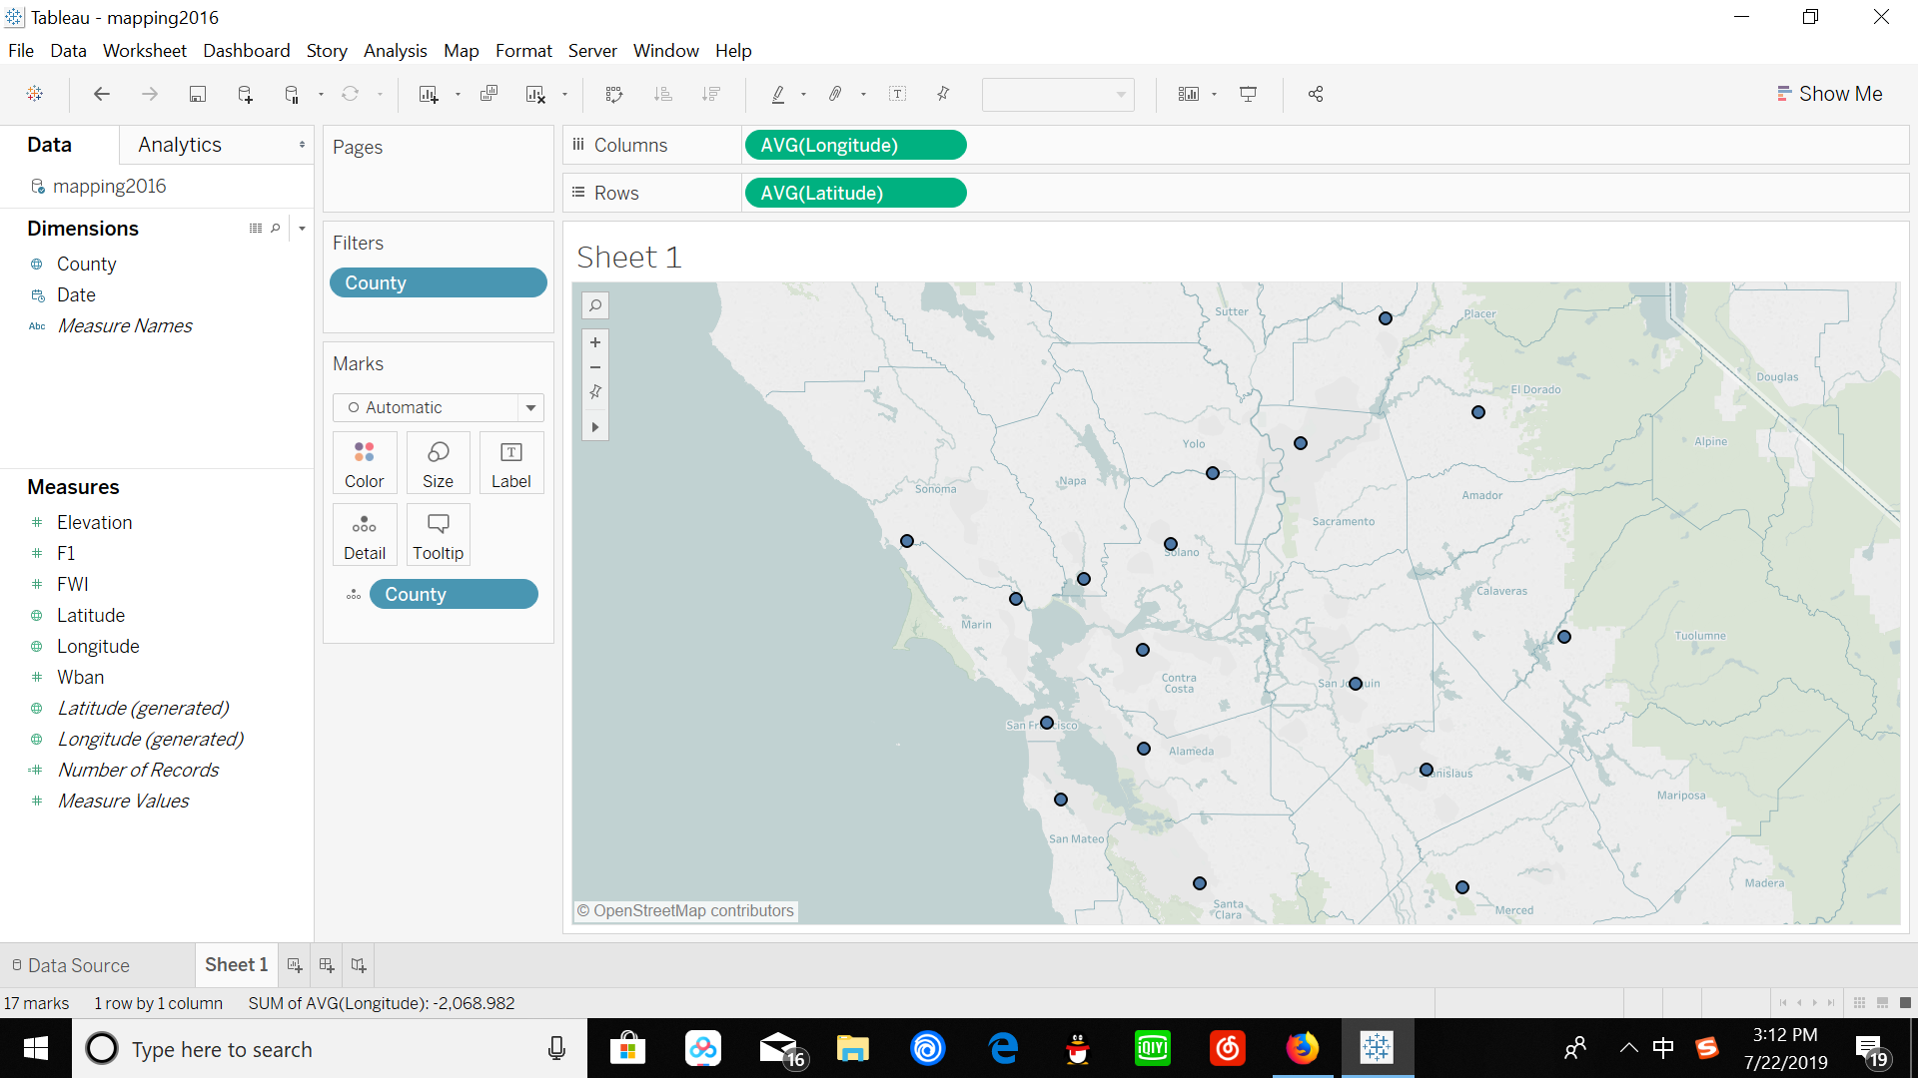
Weather Stations

Slide 10
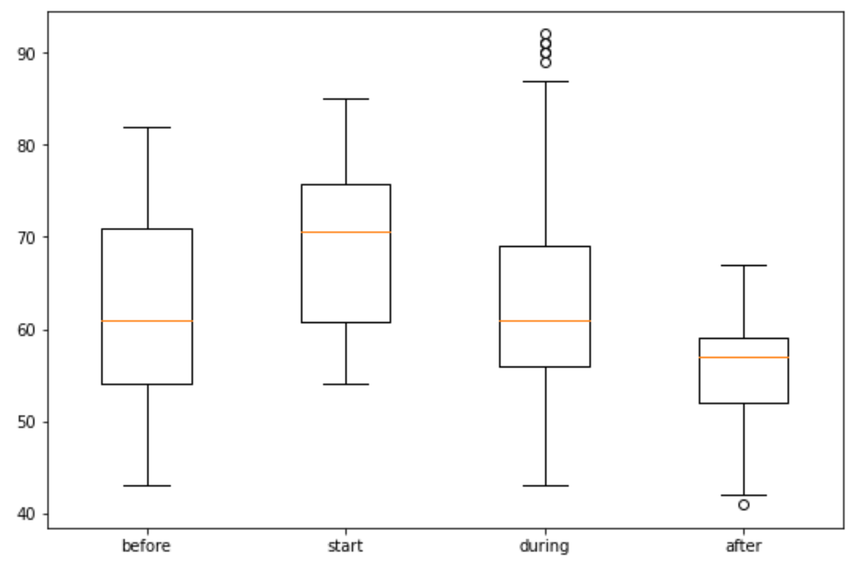
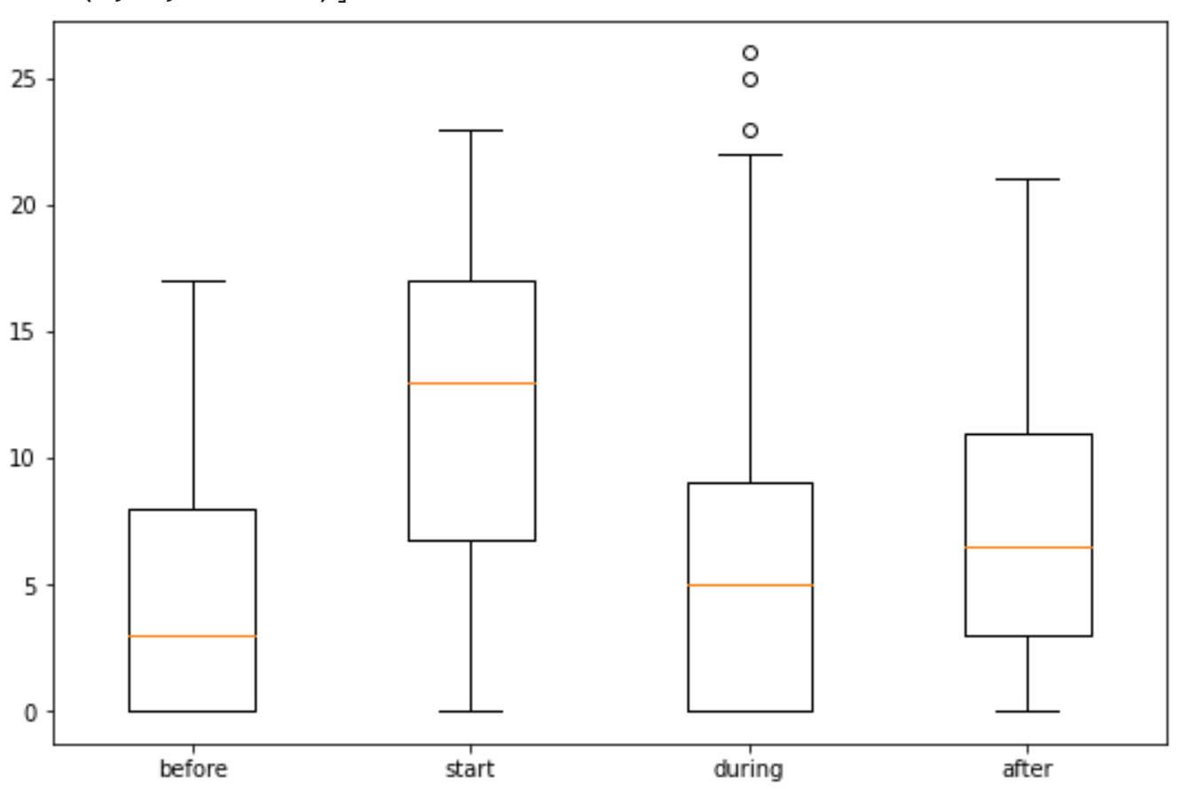
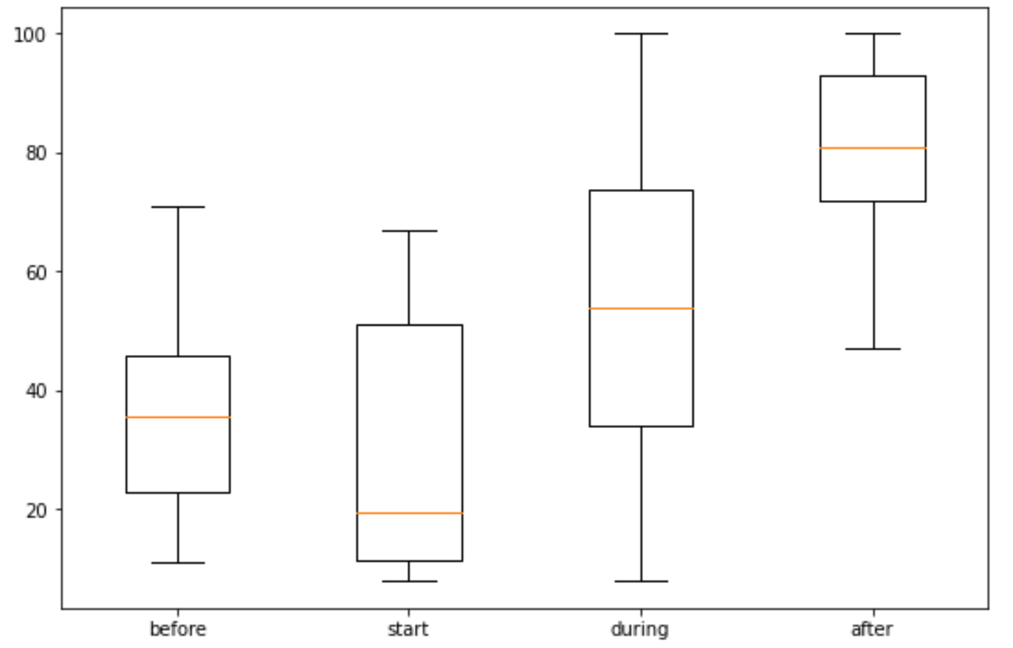
Hourly Dry-bulb temperature, relative humidity and wind speed - Comparison of Before, Start, During and After Fire
Dry-bulb temperature
Wind speed
Relative humidity

Slide 11
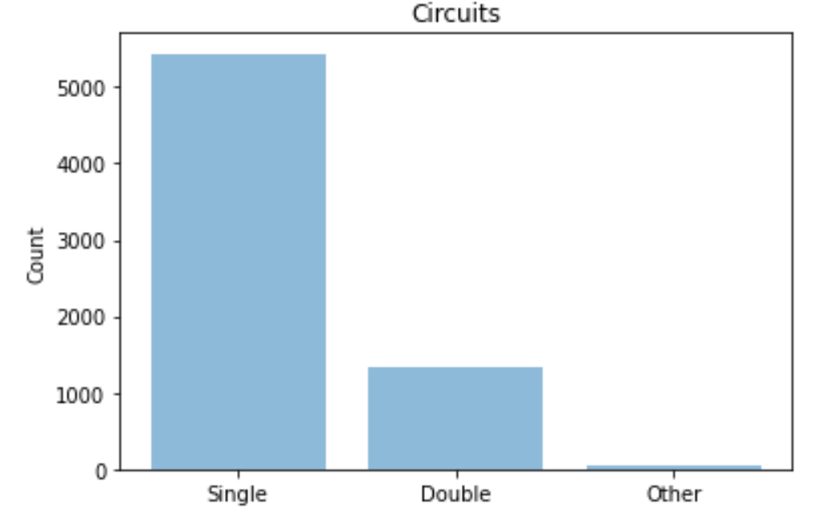
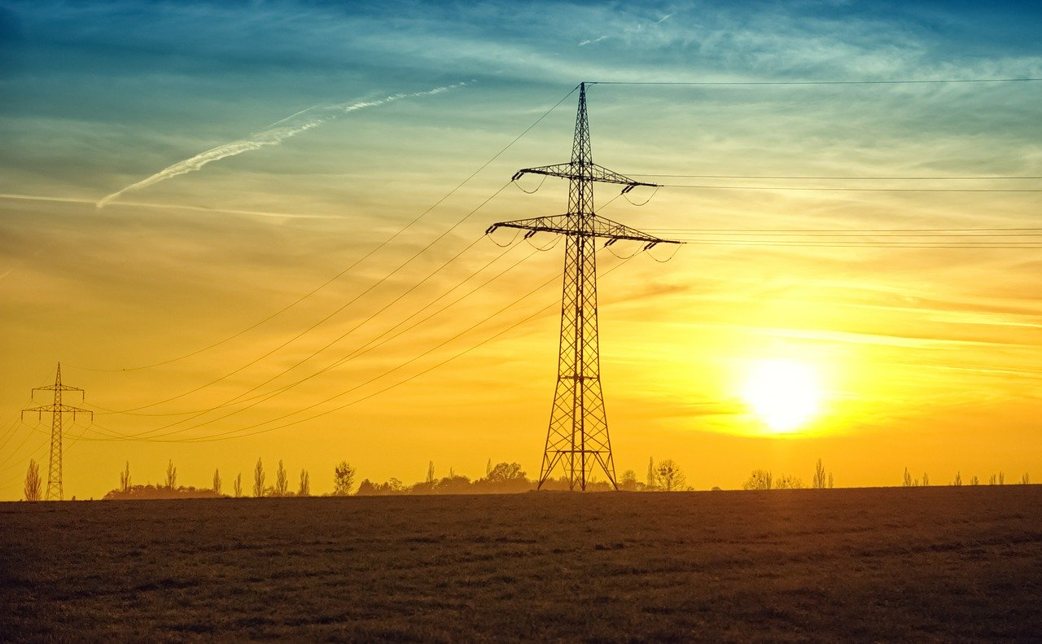
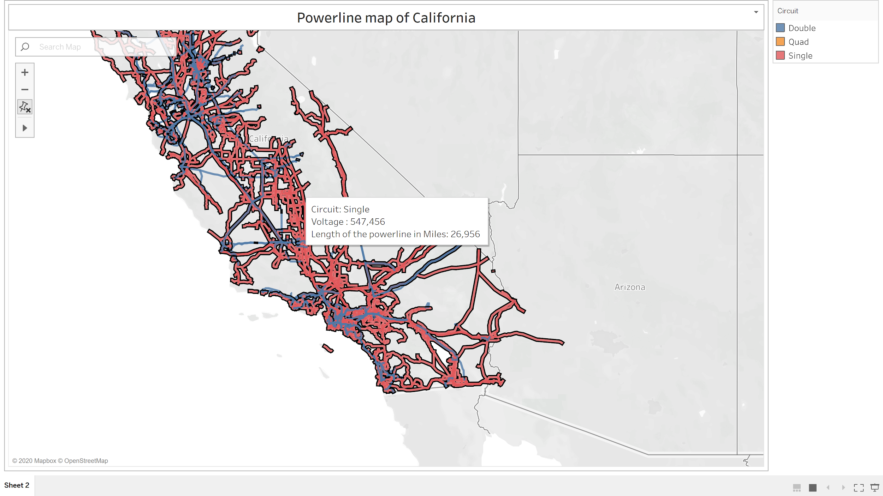
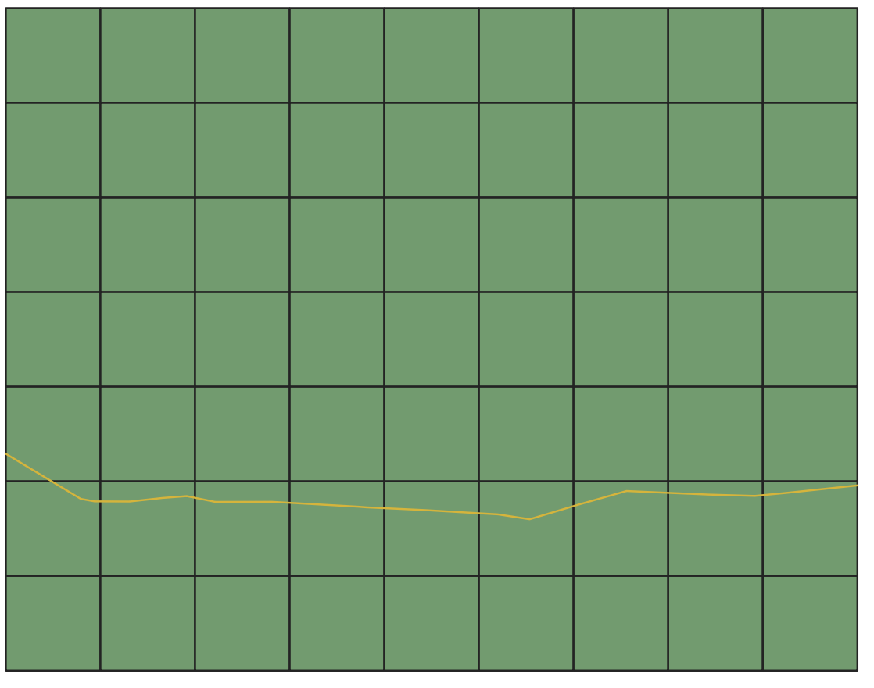
Powerline Data
California Energy Commission created an Electric transmission line geospatial data layer to display the electric transmission grid in California.
Format – Shape file
Size - 58 KB
Source - https://www.energy.ca.gov/
Converted Shape file to data frame using QGIS tool
Parameter | Description
kV | Voltage of the powerline
Owner | Owner of the powerline
Status | Whether the line is operating or not
Circuit | Type of circuit
Length (Mile) | Length of the line in miles
Length (Feet) | Length of the line in Feet

Slide 12
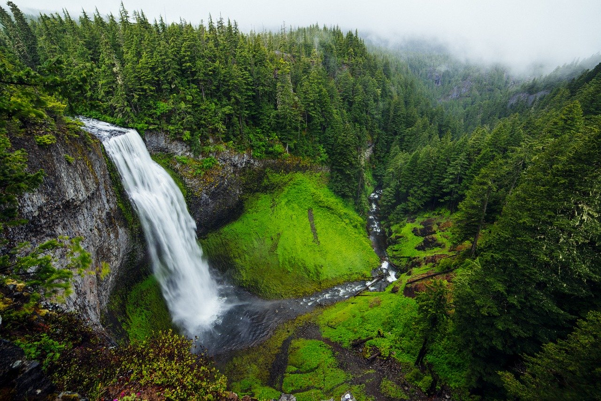
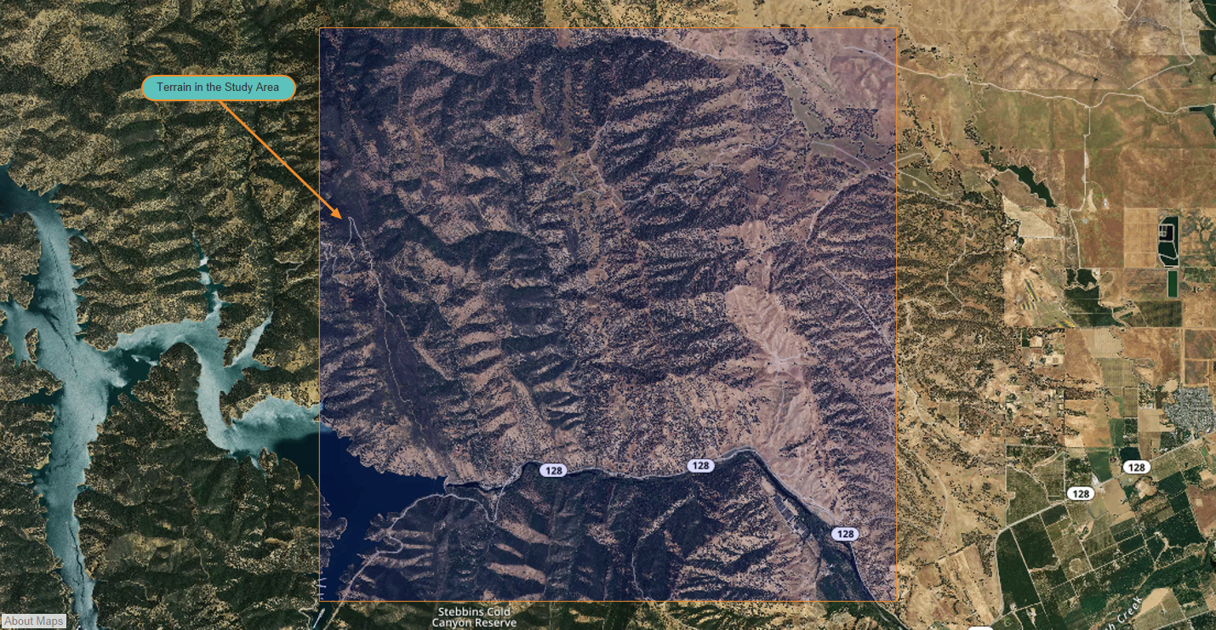
Terrain Data
United States Geological Survey provides topography information, which is available in the form of Digital Elevation Models (DEM).
Format - DEM file
Size – 1.6 GB
Calculated parameters from DEM using QGIS tool.
Source - https://www.usgs.gov/
Parameter | Description | Range | Unit
Slope | Slope of the terrain | (0, 90) | degree
Aspect | It is a compass direction that a slope face | (0, 360) | azimuth
Hill shade | Terrain surface with sun relative position. | (0,360) | azimuth

Slide 13
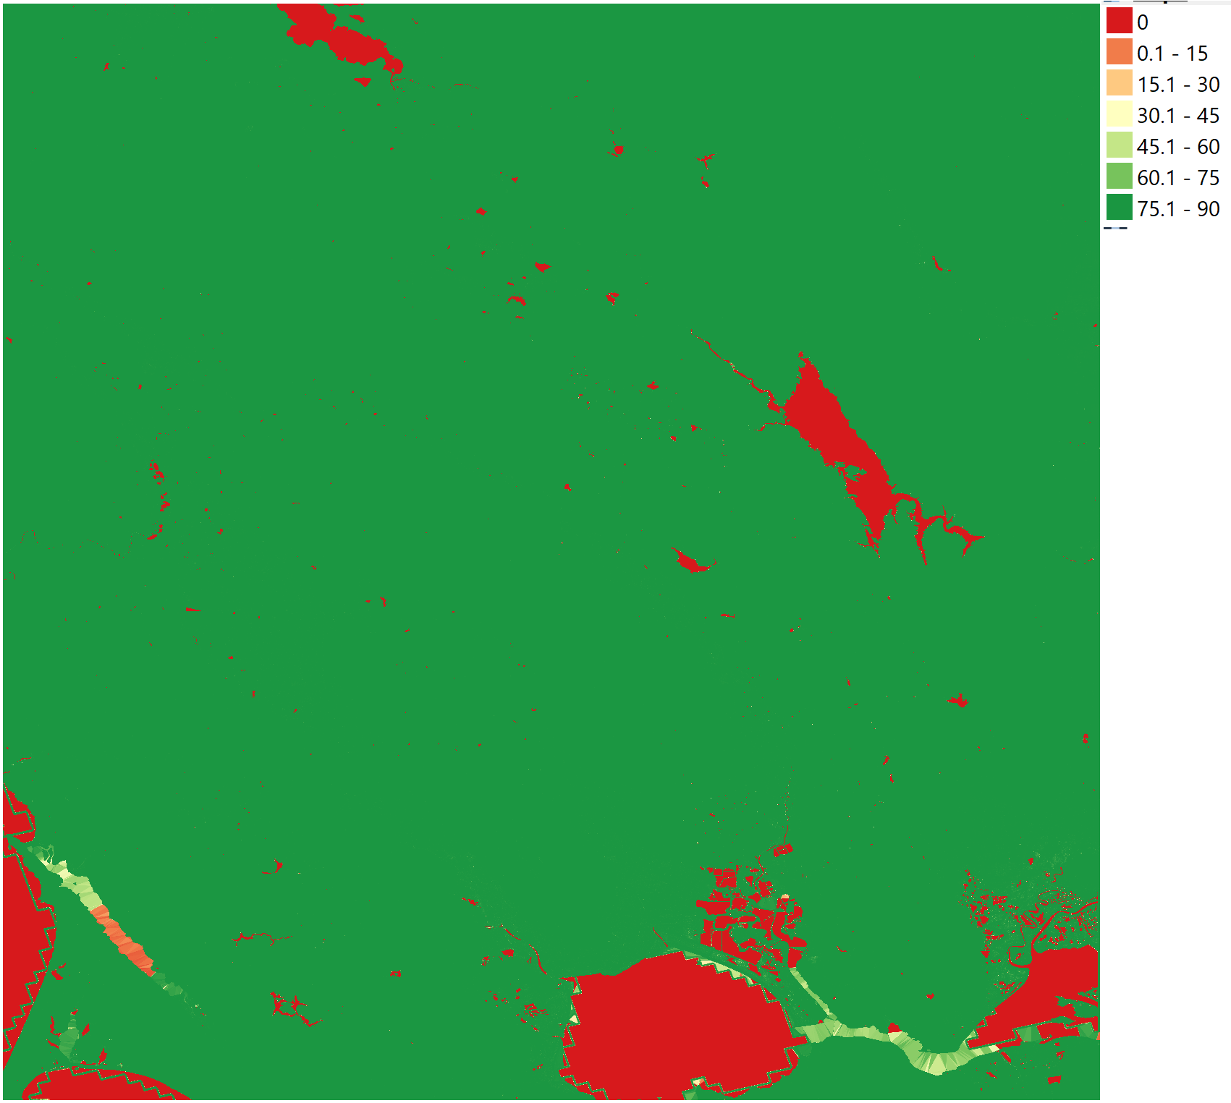
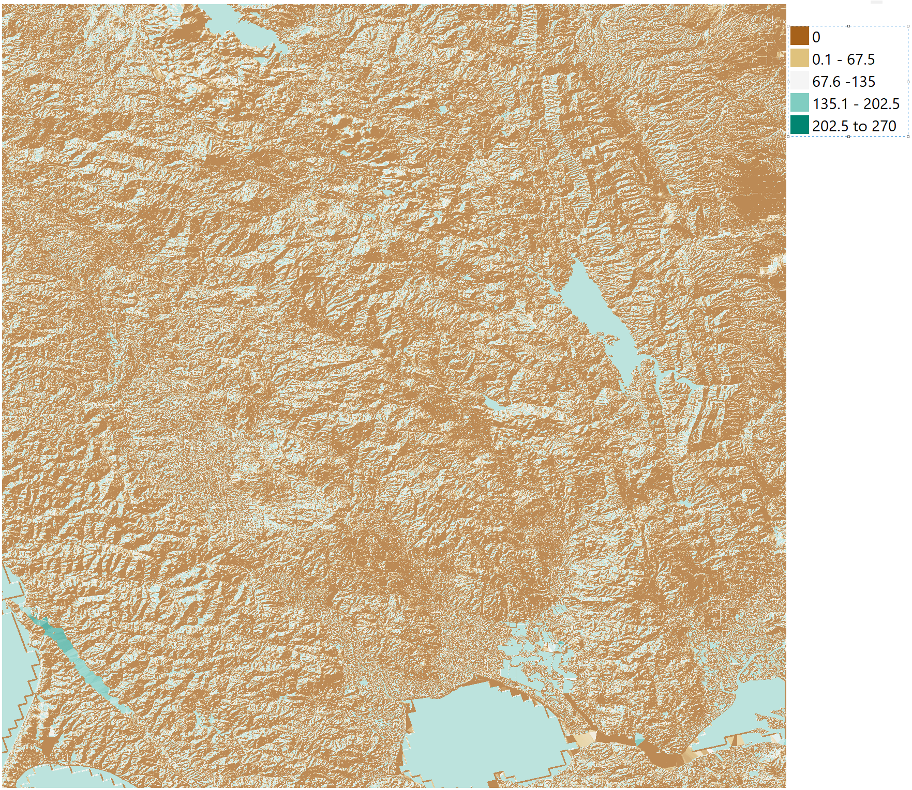
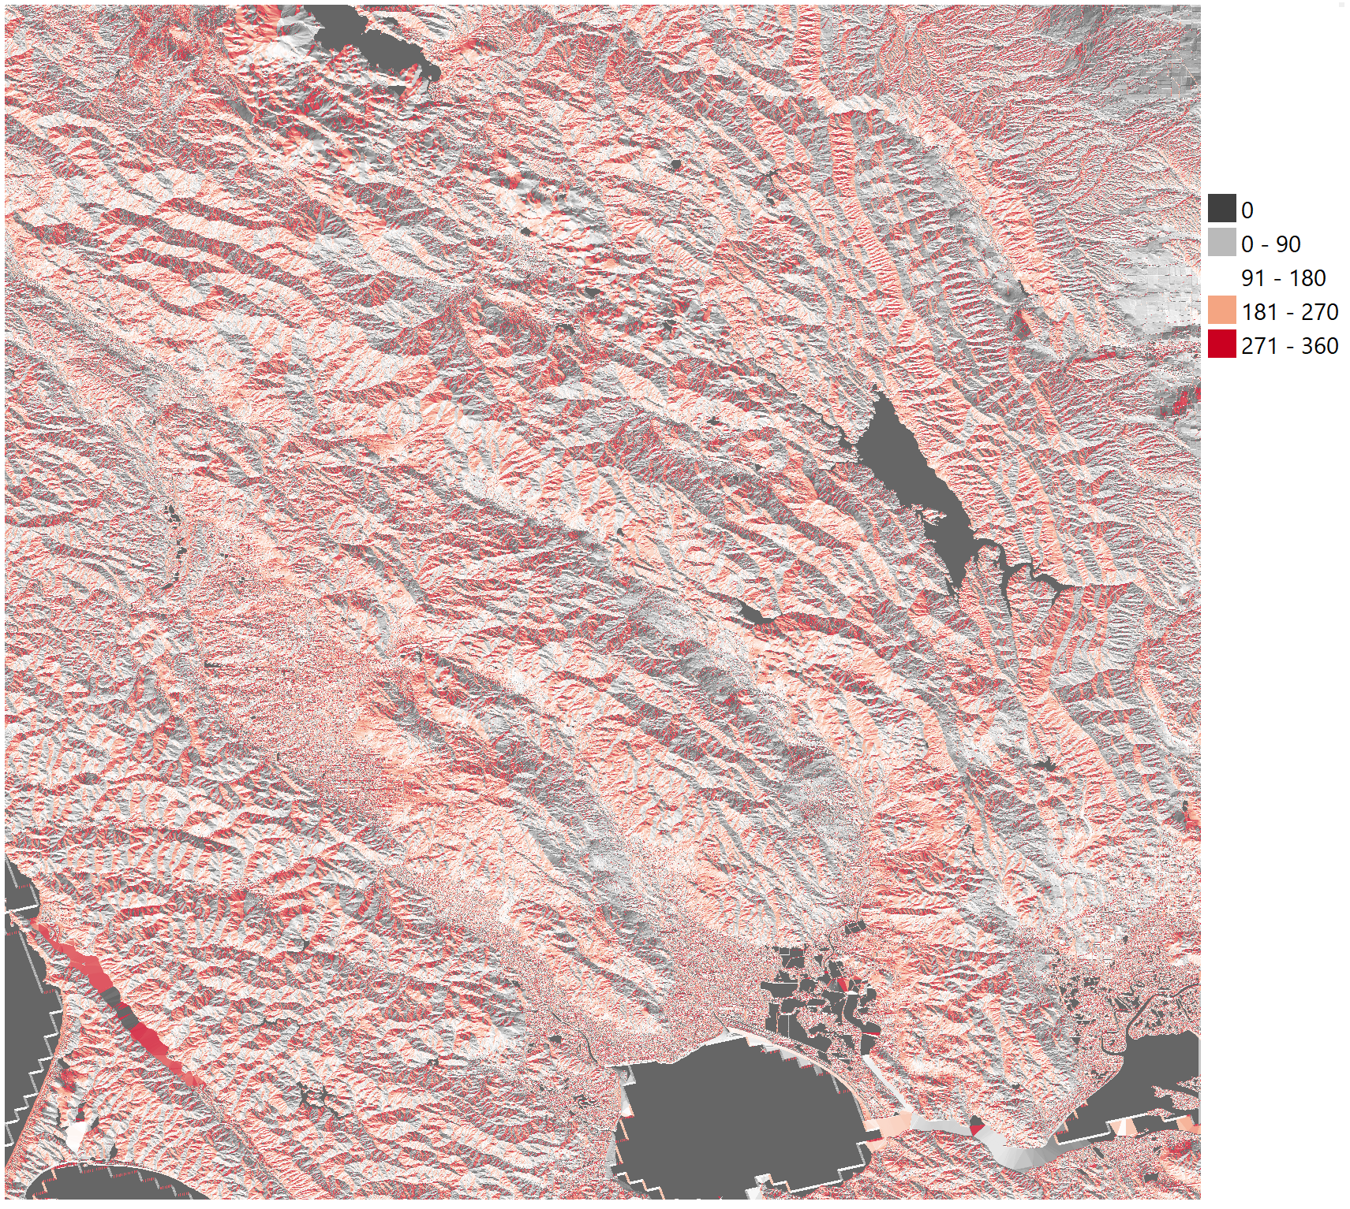
Slope, Hill Shade & Aspect

Slide 14
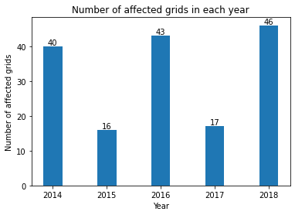
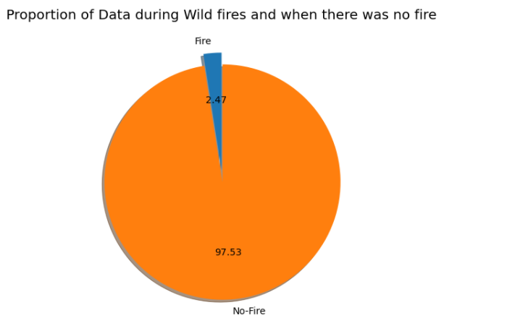
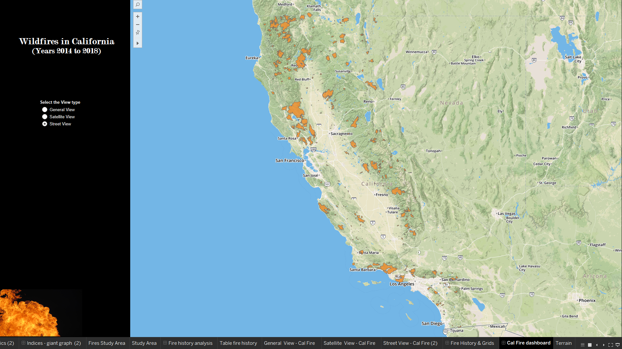
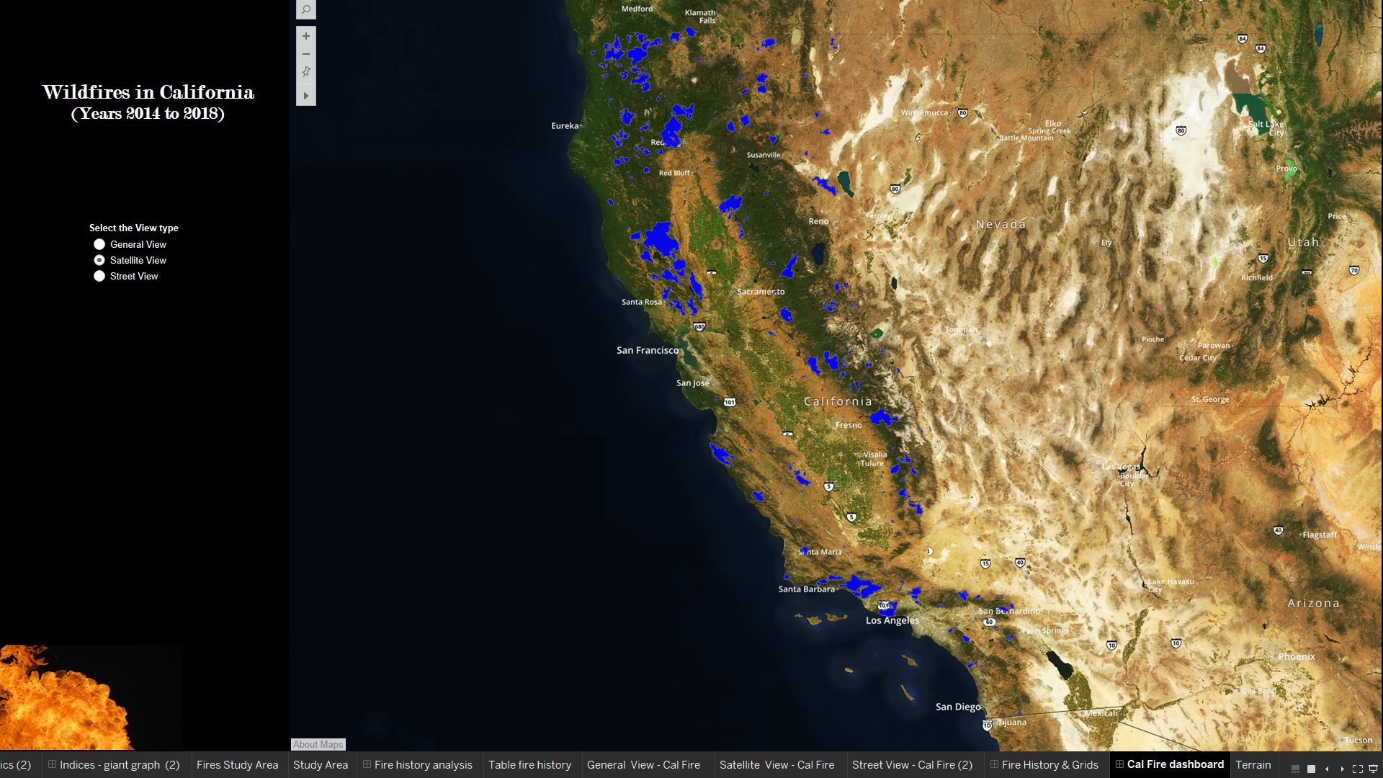
Fire History Data
Fire and Resource Assessment Program (FRAP) maintained by CAL Fire, United States Forest Service region, Bureau of Land Management and National park service.
Format - Shape file
Date range - 01/01/2014 to 12/31/2018.
Source - https://frap.fire.ca.gov/frap-projects/fire-perimeters/
Size – 80 KB
Column Name | Description | Range | Unit
Year | Year of Fire occurred. | (2016, 2018) | year
State | State where the fire occurred | ‘CA’ | NA
Fire_Name | Name of the fire | NA | NA
Alarm_Date | Alarm date of the Fire. | (01/01/2016 ,12/31/2018) | NA
Cont_Date | Containment date for fire. | (01/01/2016 ,12/31/2018) | NA
Cause | Reason for the fire. | (1,19) | NA
Report_Ac | Area Consumed in the fire | (0, 25) | acre
GIS_Acres | Area Calculated by GIS | (8.266294, 26.002495) | acre
C_Method | Collection of data method coding | (1, 1) | NA
Objective | Suppression or resource benefit | (1,1) | NA
Fire_Num | Number assigned to the fire | (00001890 1716, 00000825) | NA
Shape_Length | Length of the area burnt | (9.093210, 445282.444798) | meter
Shape_Area | Area burnt | (6.130331,1.660030e+09) | Square meter
Geometry | Shape of the area burnt | Within study area | degrees

Slide 15
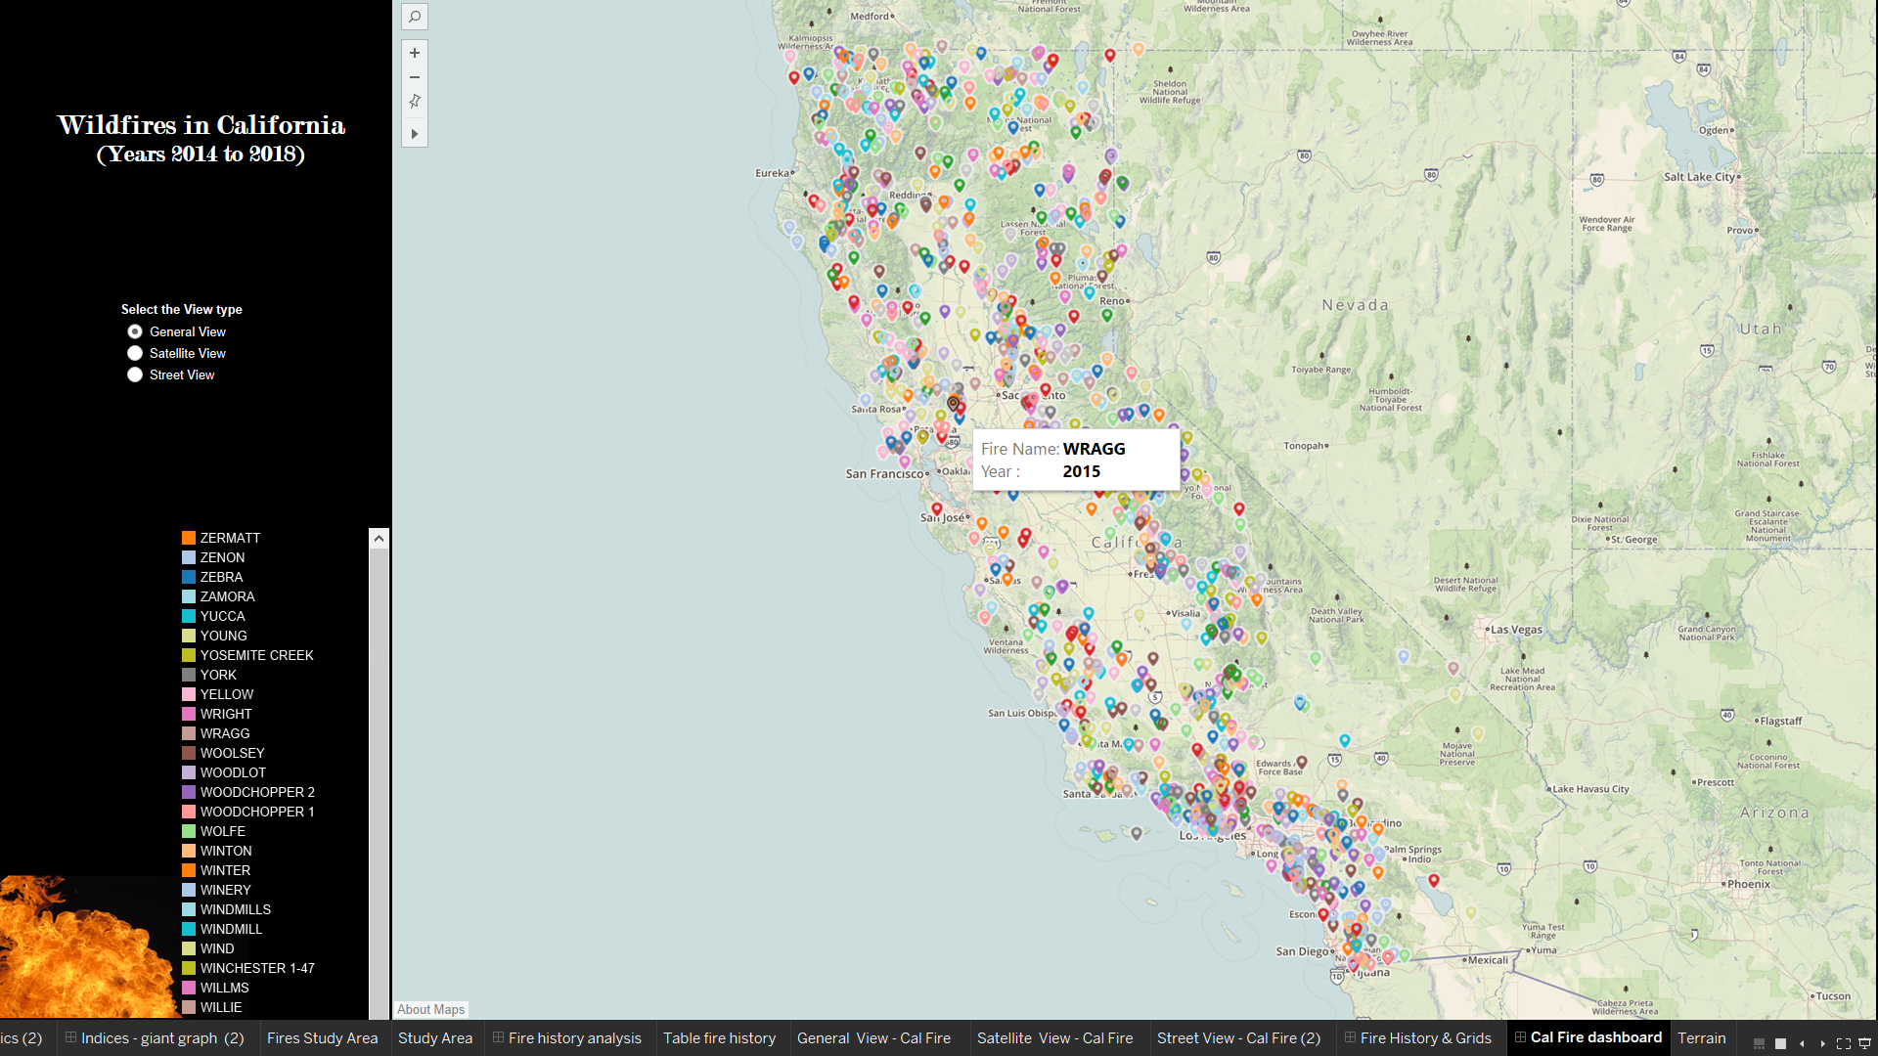

Slide 16
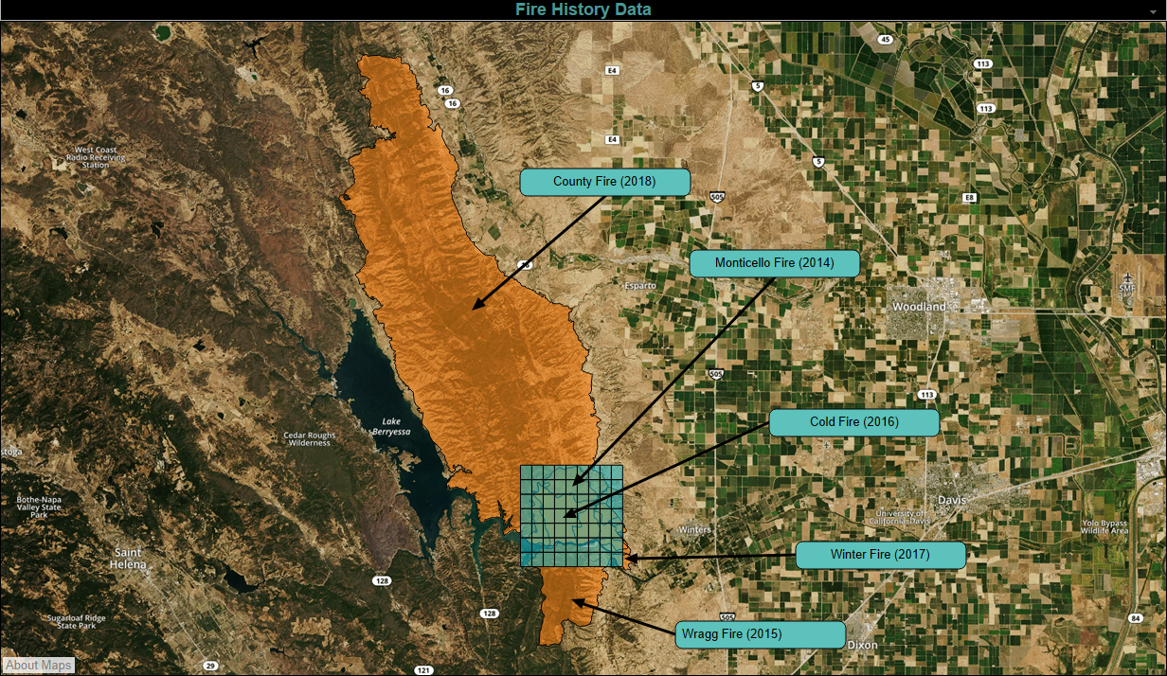
Fire History for our Study Area

Slide 17
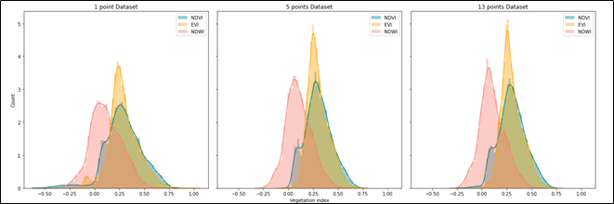
Vegetation Data
Landsat 8 remote-sensing satellite data was extracted from Google Earth Engine (GEE) using Python API.
Custom-made python functions were used for calculating indices from bands as well as fetching aggregate values.
Aggregates were consistent and reliable as they were pre-processed and devoid of atmospheric hindrances.
Size - 16 MB (final dataset)
Dimension - 226044 rows x 8 columns
Frequency - 16 days (Landsat 8)
Spatial Accuracy - 15 to 30 metres
Date Range - 1st January,2014 to 3rd January, 2020
Fields | Data Type | Description | Range | Unit
id | Integer | Unique id for the inner grid | 1 to 63 | NA
Co-ordinates – Corners and Centroid | Float | Separate latitude and longitude of Left, right, top, bottom and centroid latitude and longitude of each grid | ((38.4992, -122.1241), (38.5692, -122.0341)) | Degree
Polygon/Geometry | Polygon | Grid coordinates of the inner grid | ((38.4992, -122.1241), (38.5692, -122.0341)) | Degree
start_date | Datetime | Start date for fetching the 8-day composite indices | (01/01/2015, 12/27/2019) | NA
end_date | Datetime | 7 days added to the start date provides the end date for 8-day composite indices | (01/08/2015, 1/3/2020) | NA
NDVI | Float | Calculated from red and infrared bands. | -1 to +1 | NA
EVI | Float | Calculated from visible and near-infrared bands. | -1 to +1 | NA
NDWI | Float | Calculated from short-wave infrared and near infrared bands | -1 to +1 | NA
13 co-ordinates for corners, diagonals, midpoints of edges and corners | Float | 13 columns corresponding to the 13 points sampled from each inner grid. The points are Centroid, 4 diagonal points, 4 midpoints of edges and corner points. | ((38.4992, -122.1241), 38.5692, -122.0341)) | Degree
Notes:
30 m (multispectral) and 15 m (panchromatic)

Slide 18
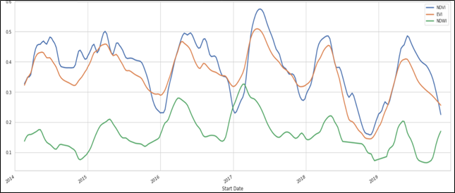
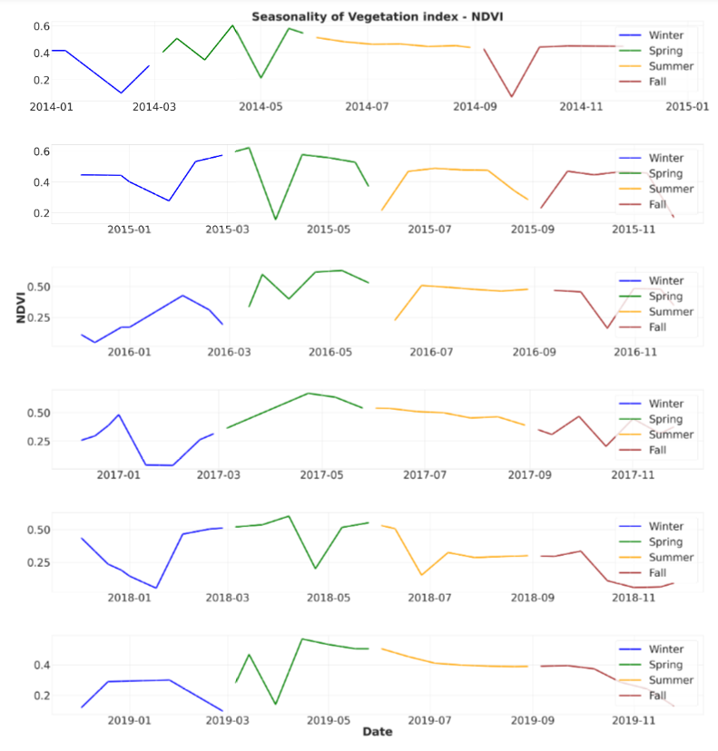
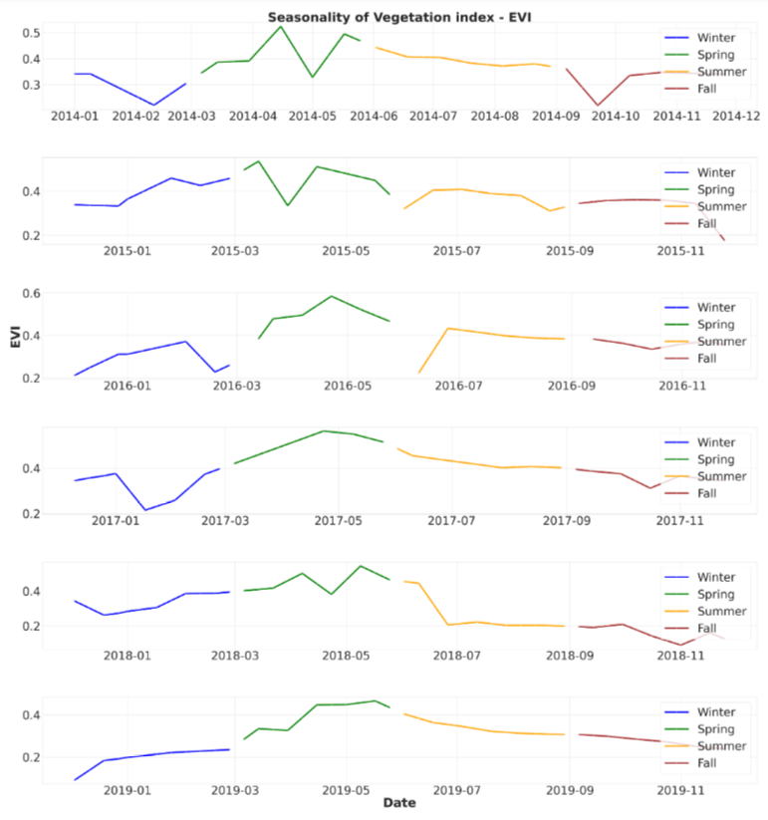
Vegetation indices are measures that map the density of green vegetation around the globe. Below are the chosen relevant indices.
Normalized Difference Vegetation Index (NDVI) - Standard measure of healthy vegetation
Enhanced Vegetation Index (EVI) - Enhanced version of NDVI
Normalized Difference Water Index (NDWI) - Water content in Vegetation
Data sampling - For each grid, a 1-point (Centroid only), 5-point (Centroid and corners) and 13-points dataset (Centroid, Corners, edges of midpoints and diagonals) were generated. The 13-point was chosen due to its completeness after a thorough statistical analysis.

Slide 19
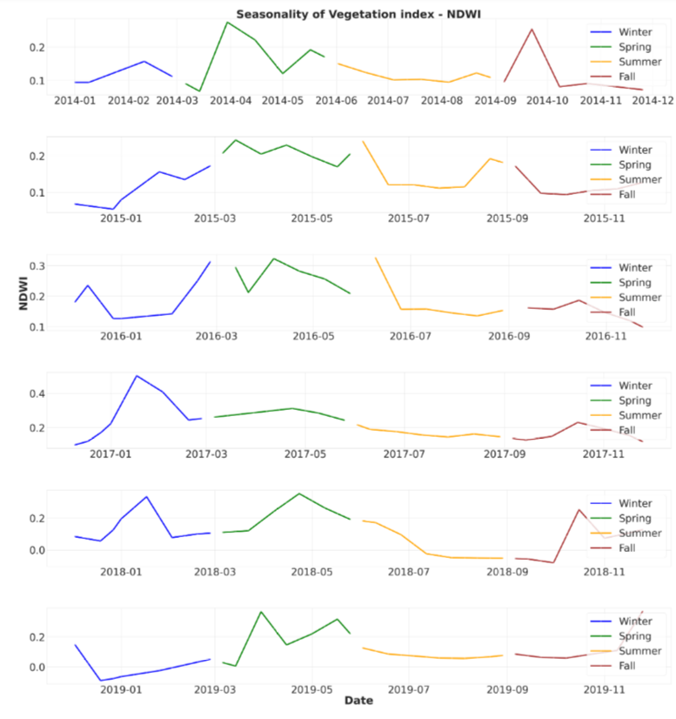
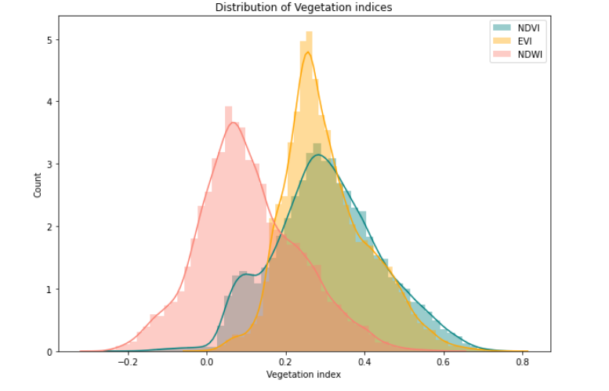
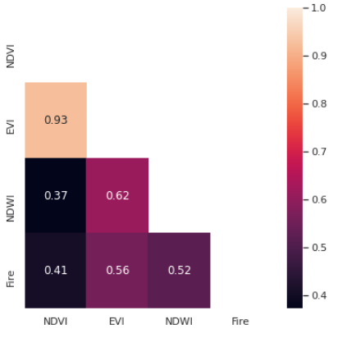
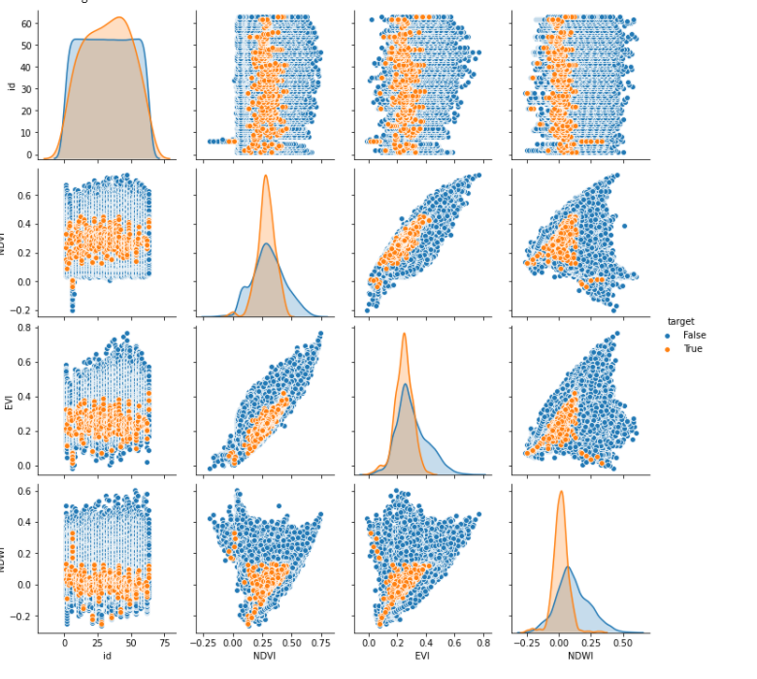
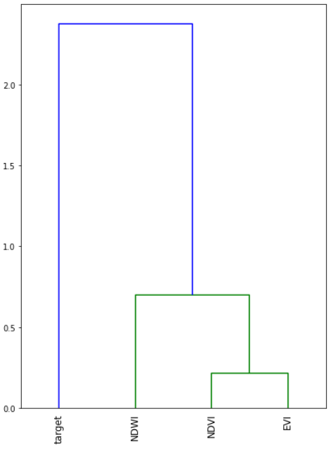

Slide 20
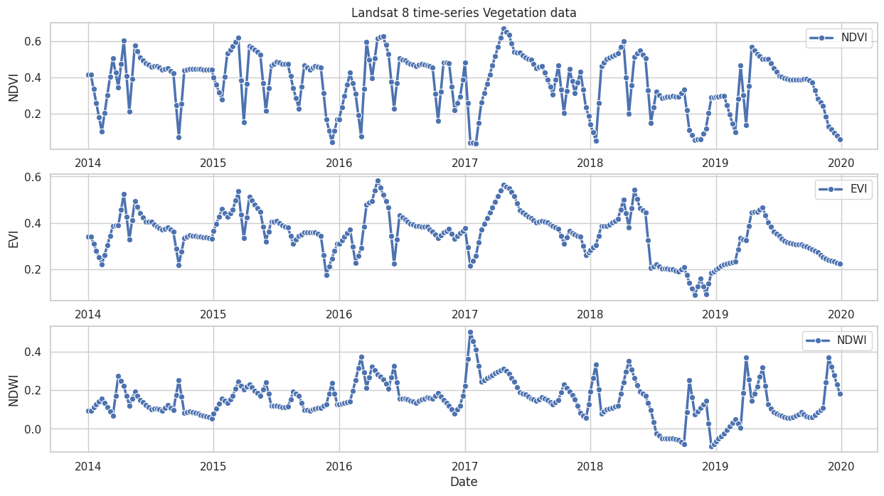
Landsat 8 Vegetation - time-series data (dashboards in coming slides)

Slide 21
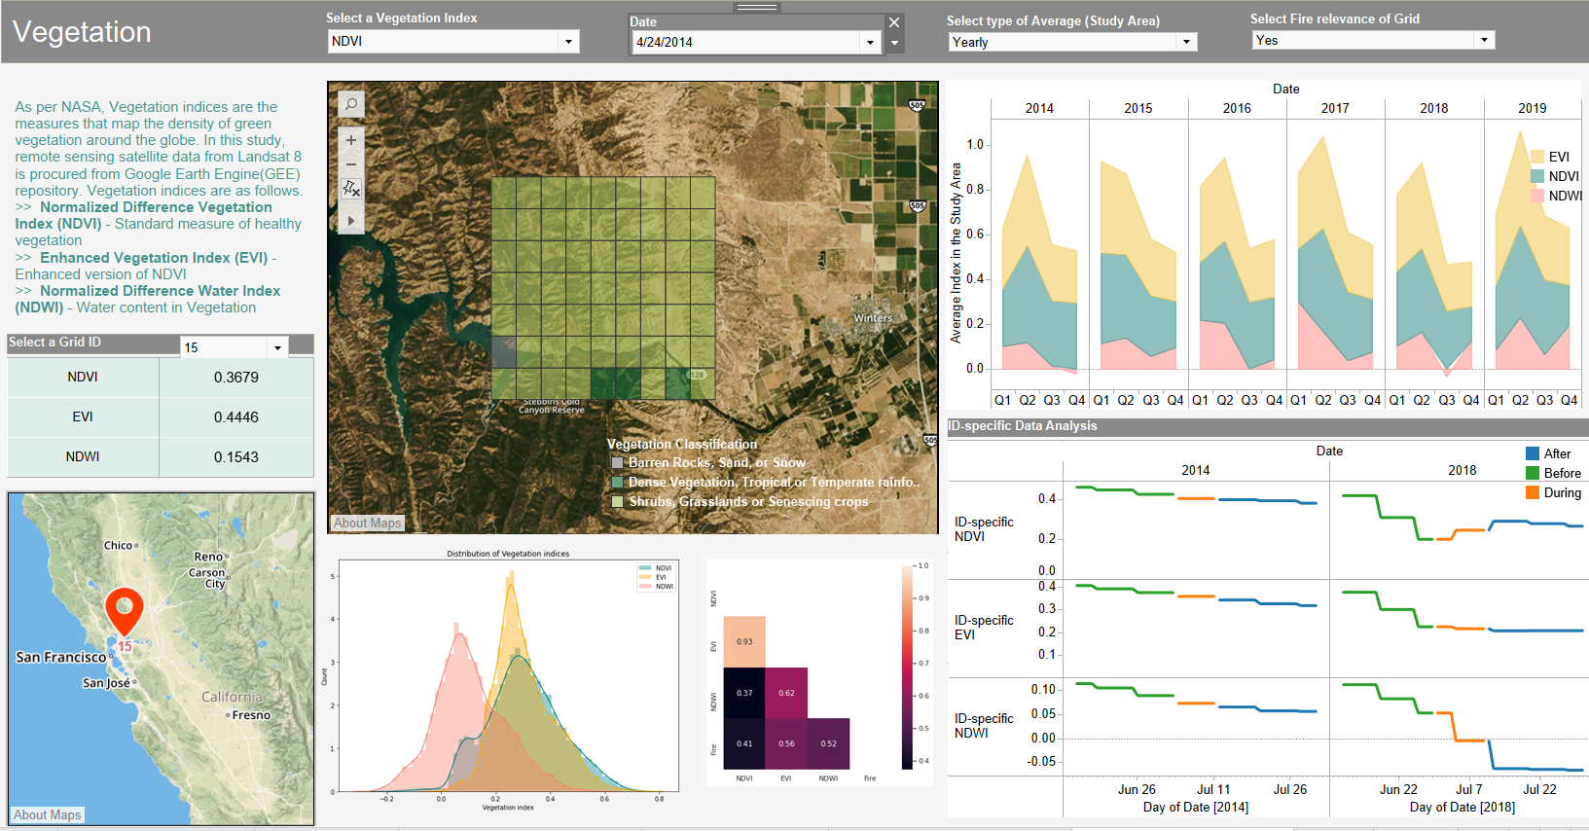

Slide 22
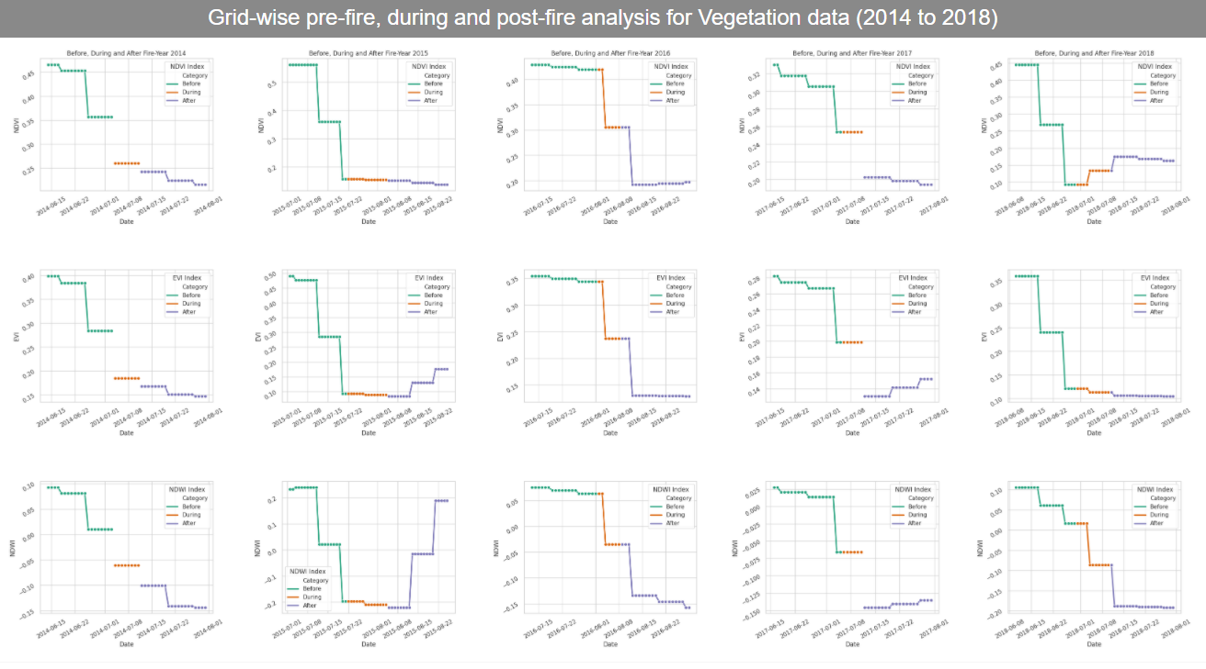
Grid-wise pre-fire, during and post-fire analysis for Vegetation (2014 - 2018)

Slide 23
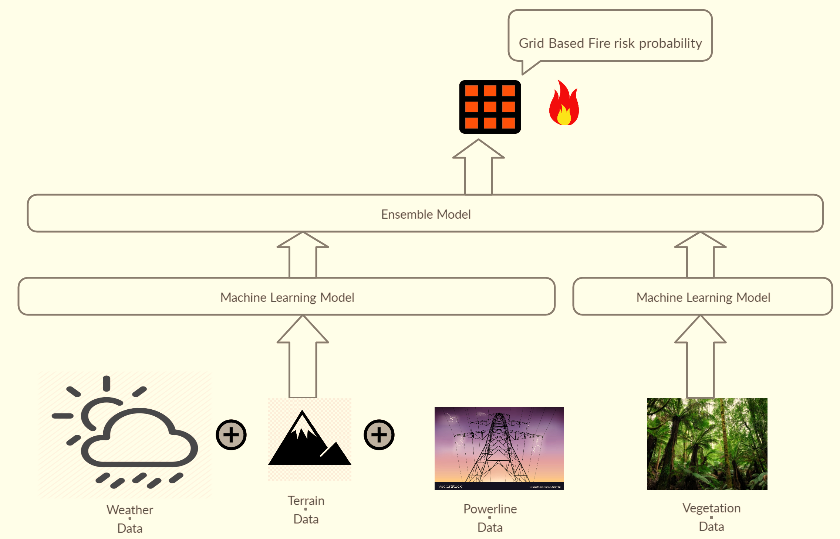
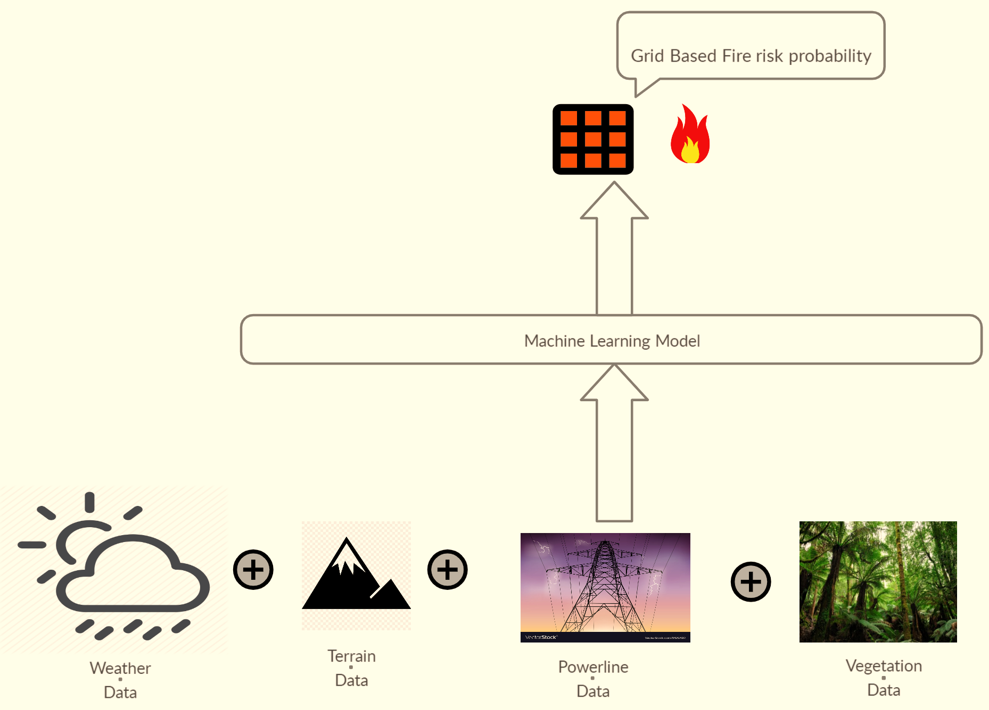
Proposed Solutions
Ensemble Model
Combined Model

Slide 24


Accuracy Comparison of the Machine learning algorithms
Combined Models
Criteria for selecting Machine Learning (ML) Algorithms for our Model:
Accuracy of the model.
Minimize False Negatives.
Interpretability of the model.
Algorithms with least assumptions about the data.
Scalability of the model.
Infrastructural resources at hand.
Ensemble Models

Slide 25

Model Experiments
Model | Accuracy | Hyper Parameters used
Random Forest | 92 | n_estimators = 200
Adaboost | 91.5 | n_estimators= 50, learning_rate = 1
Gradient Boosting trees | 90.5 | loss = deviance, n_estimators= 100
Weighted Decision Trees | 89.1 | criterion = gini, splitter = best
MLP | 86.1 | activation = Softmax, solver = adam
LSTM | 91.6 | Dropout = 0.2, activation = Softmax
Random Forest Tree

Slide 26


Model Architecture
Ensemble Model Architectre
Final Combined Model
Final Ensemble Model

Slide 27

Evaluation strategy

Slide 28


Threshold tuning
Receiver Operating Characteristic (ROC Curve) plots the False positive rates versus the True positive rates predicted by the model.
Area under the curve is a true mark of model efficiency and its ability to classify.
Using this ROC Curve, best threshold value for classification was determined.
Tuning the threshold values reduced the False Negatives and improved accuracy of model.
Improved Model results with the best Threshold
ROC Curve with the best Threshold value
92% Accuracy
0.47 Threshold

Slide 29





Evaluation Metrics for Random Forest (Combined Model)
Confusion matrix is a tabular representation of the number of true and false predictions.
Classification Report is based on he confusion matrix and shows the percentage for Precision, recall and F1 Score for all classes.
Learning curves are helpful in evaluating the feasibility, scalability and performance of the model.

Slide 30




Conclusion
A robust data-driven fire prediction system named ‘Spartan Wild Fire Risk Prediction system (SWiPS)’ was created by modeling the precursor fire conditions with a combination strategy that mimics real-time wildfire dynamics.
It comprises a powerful backend algorithm connected to a front-end interface using Flask that displays the data analyses and results of our projects, along with an add-on option for expert users to determine the fire probability at a specified location.
Datasets used: Vegetation, Weather, Fire history, Terrain and Powerlines.
Drawbacks: Requires high quality data which are not readily available,confined to our study area until further trained.
Challenges: Complexity of parameters, lack of accessible and affordable data acquisition, pre-processing and modeling conundrums.

Slide 31


Lessons Learned
High resolution consistent data is expensive, unless government sponsored.
Ready availability of Satellite data in cloud catalogs.
Usage of Python Application programming interface (API) and plugins for data extraction.
Importance of feasibility check and null value imputation.
Visualization for isolation of anomalies.
Geographic and spatial data maps using QGIS and Tableau.
Sensor data quality assurance procedure for mechanical failure, data transformation failure and collection failure.
Hyperparameter tuning, data subsets and experimentation and myriad techniques for evaluation of your prediction results.
Impressive capability of Folium, Tableau (Desktop and Public) and Flask for interactive maps, dashboards and user interface generation.

Slide 32




Recommendations
Ideal successor to this undertaking is Fire behavior and spread studies
Study and formulate the Fuel and fire dynamics, with the help of experts to integrate newer accurate indices in our modelling system.
Inclusion of additional metrics, parameters and algorithms.
Access commercial data sources with exceptional spatial and temporal resolution if funding is available.
Consider parameters such as human activities, lightening, debris, campfire, smoking when data is published by concerned authorities.
Increase the area and wider the scope to include management and alarm system.
Data quality assurance standards and missing value imputation techniques can be juxtaposed and compared before modelling.
Integrate real-time data collection to the User interface for a robust data extraction mechanism.

Slide 33


DEMO

Slide 34

Thank
you!
Special thanks to Dr. Jerry Gao, Dr. Lee Chang, NASA, Cal Fire, Everbright technologies, among others.

Slide 35
Demo Screenshots

Slide 36

Homepage

Slide 37


Slide 38


Slide 39


Slide 40


Slide 41


Slide 42


Slide 43


Slide 44


Slide 45


Slide 46


Slide 47

Weather dashboard here

Slide 48


Slide 49


Slide 50
Thank you again!!

